Slide 1
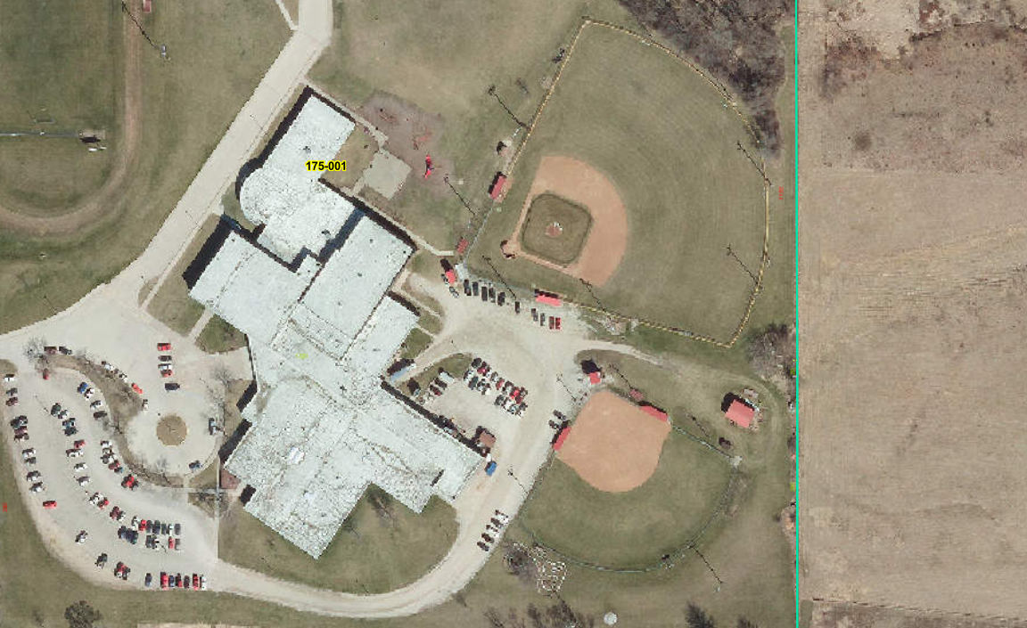

Central Decatur CSD
Planning for Success
March 12th, 2025

Slide 2
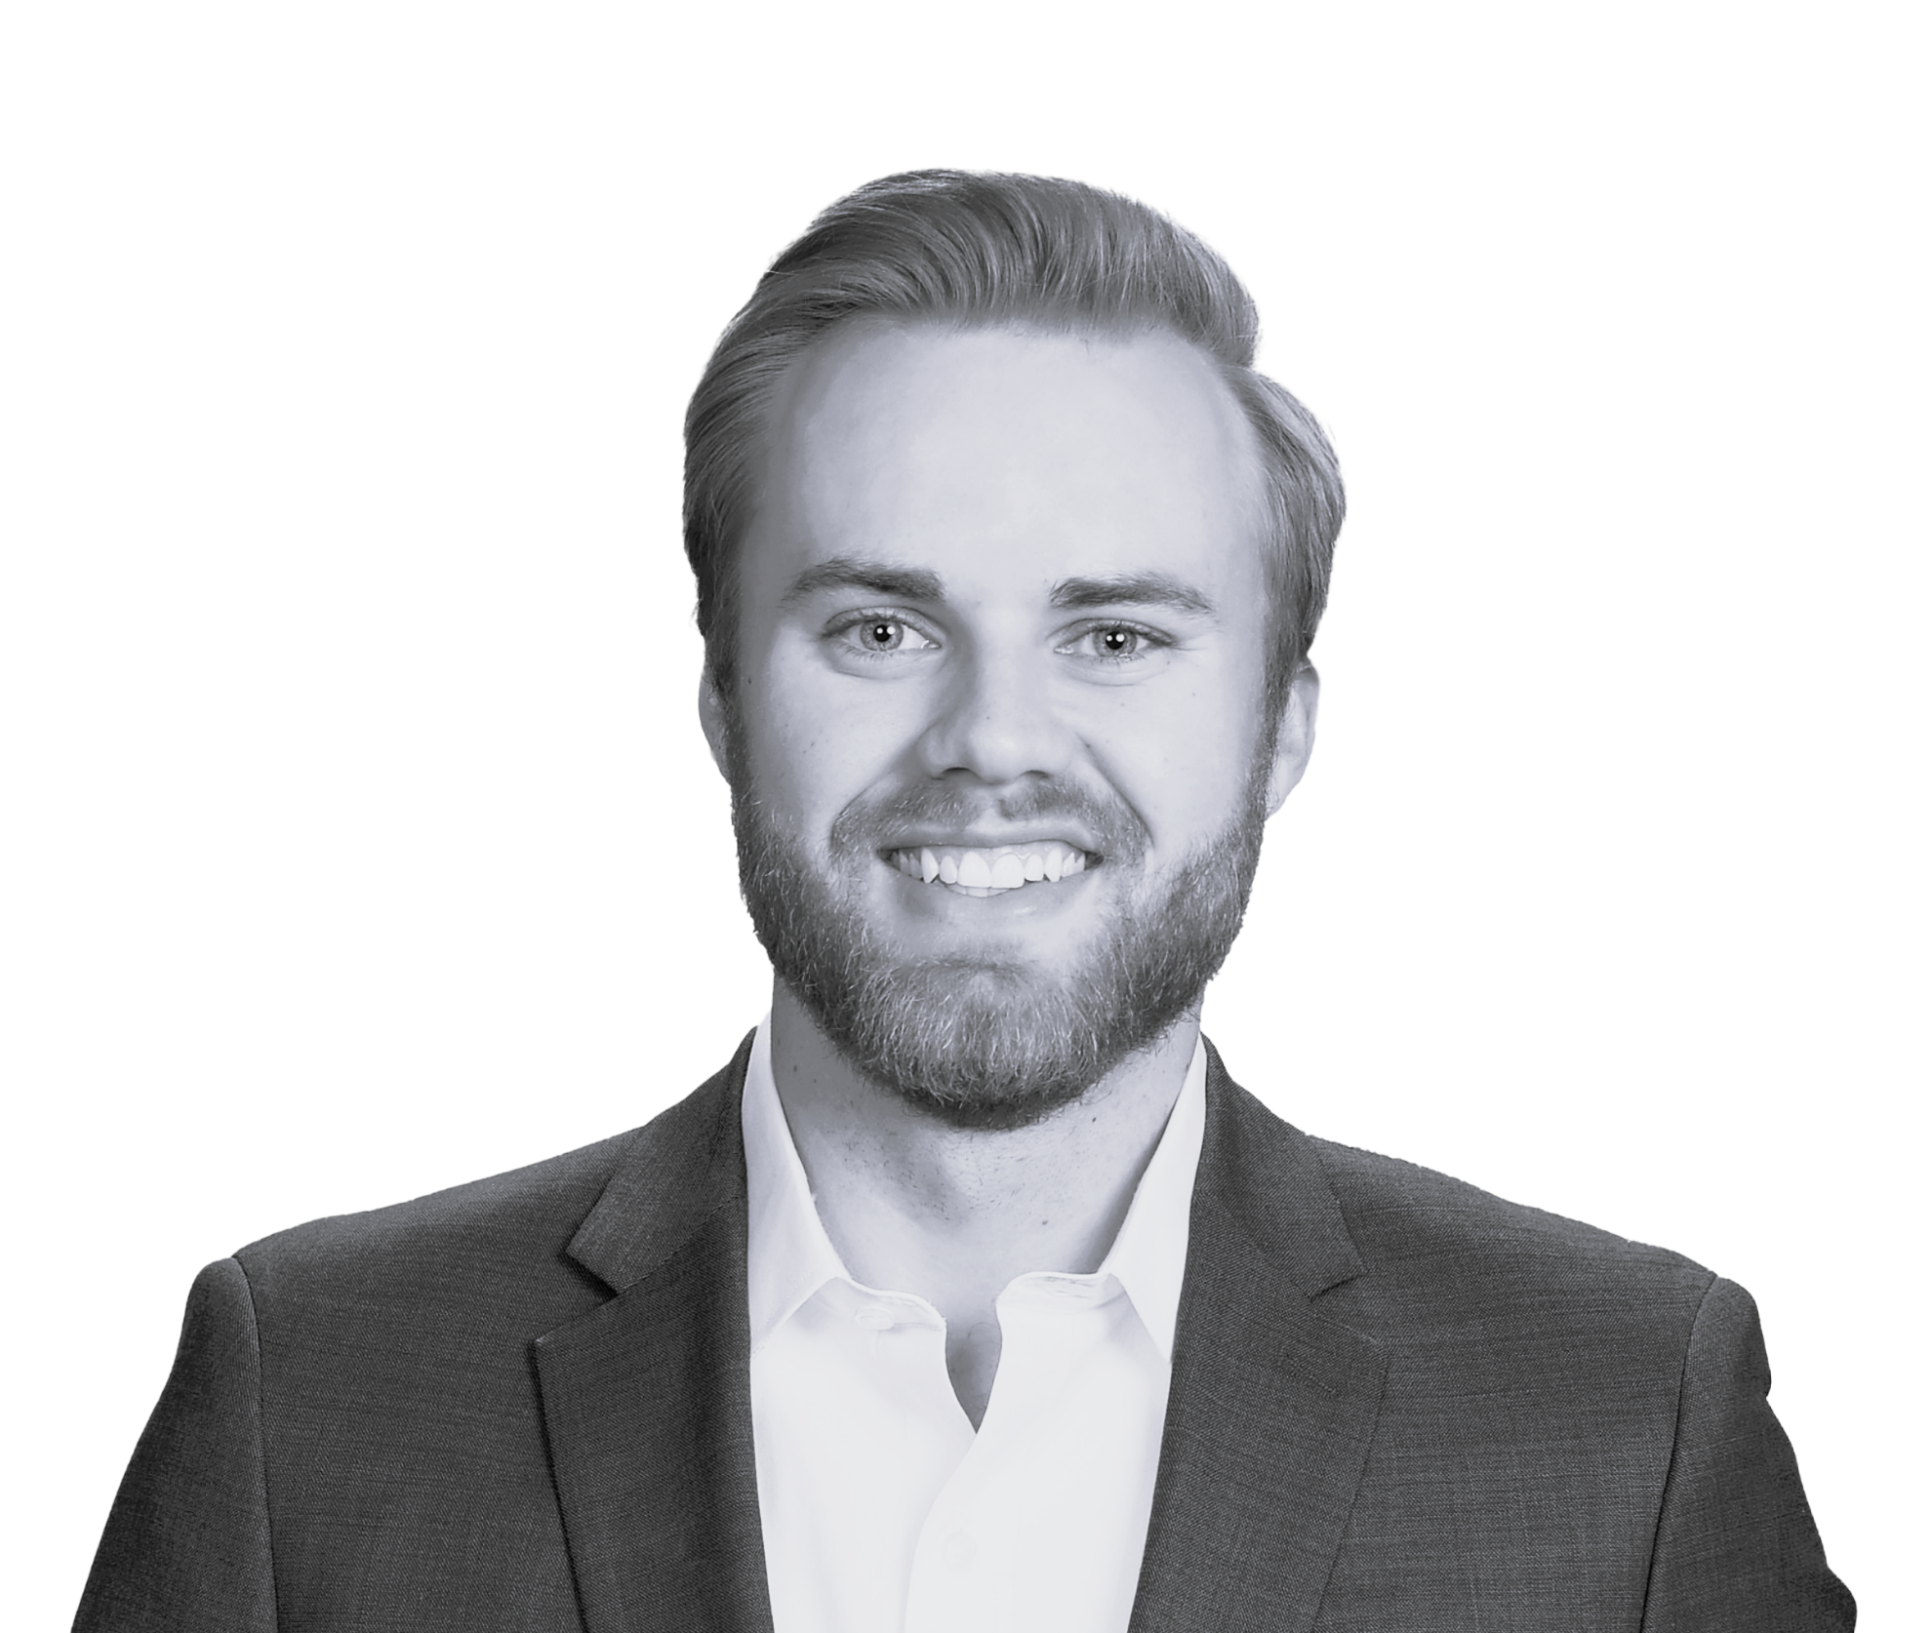
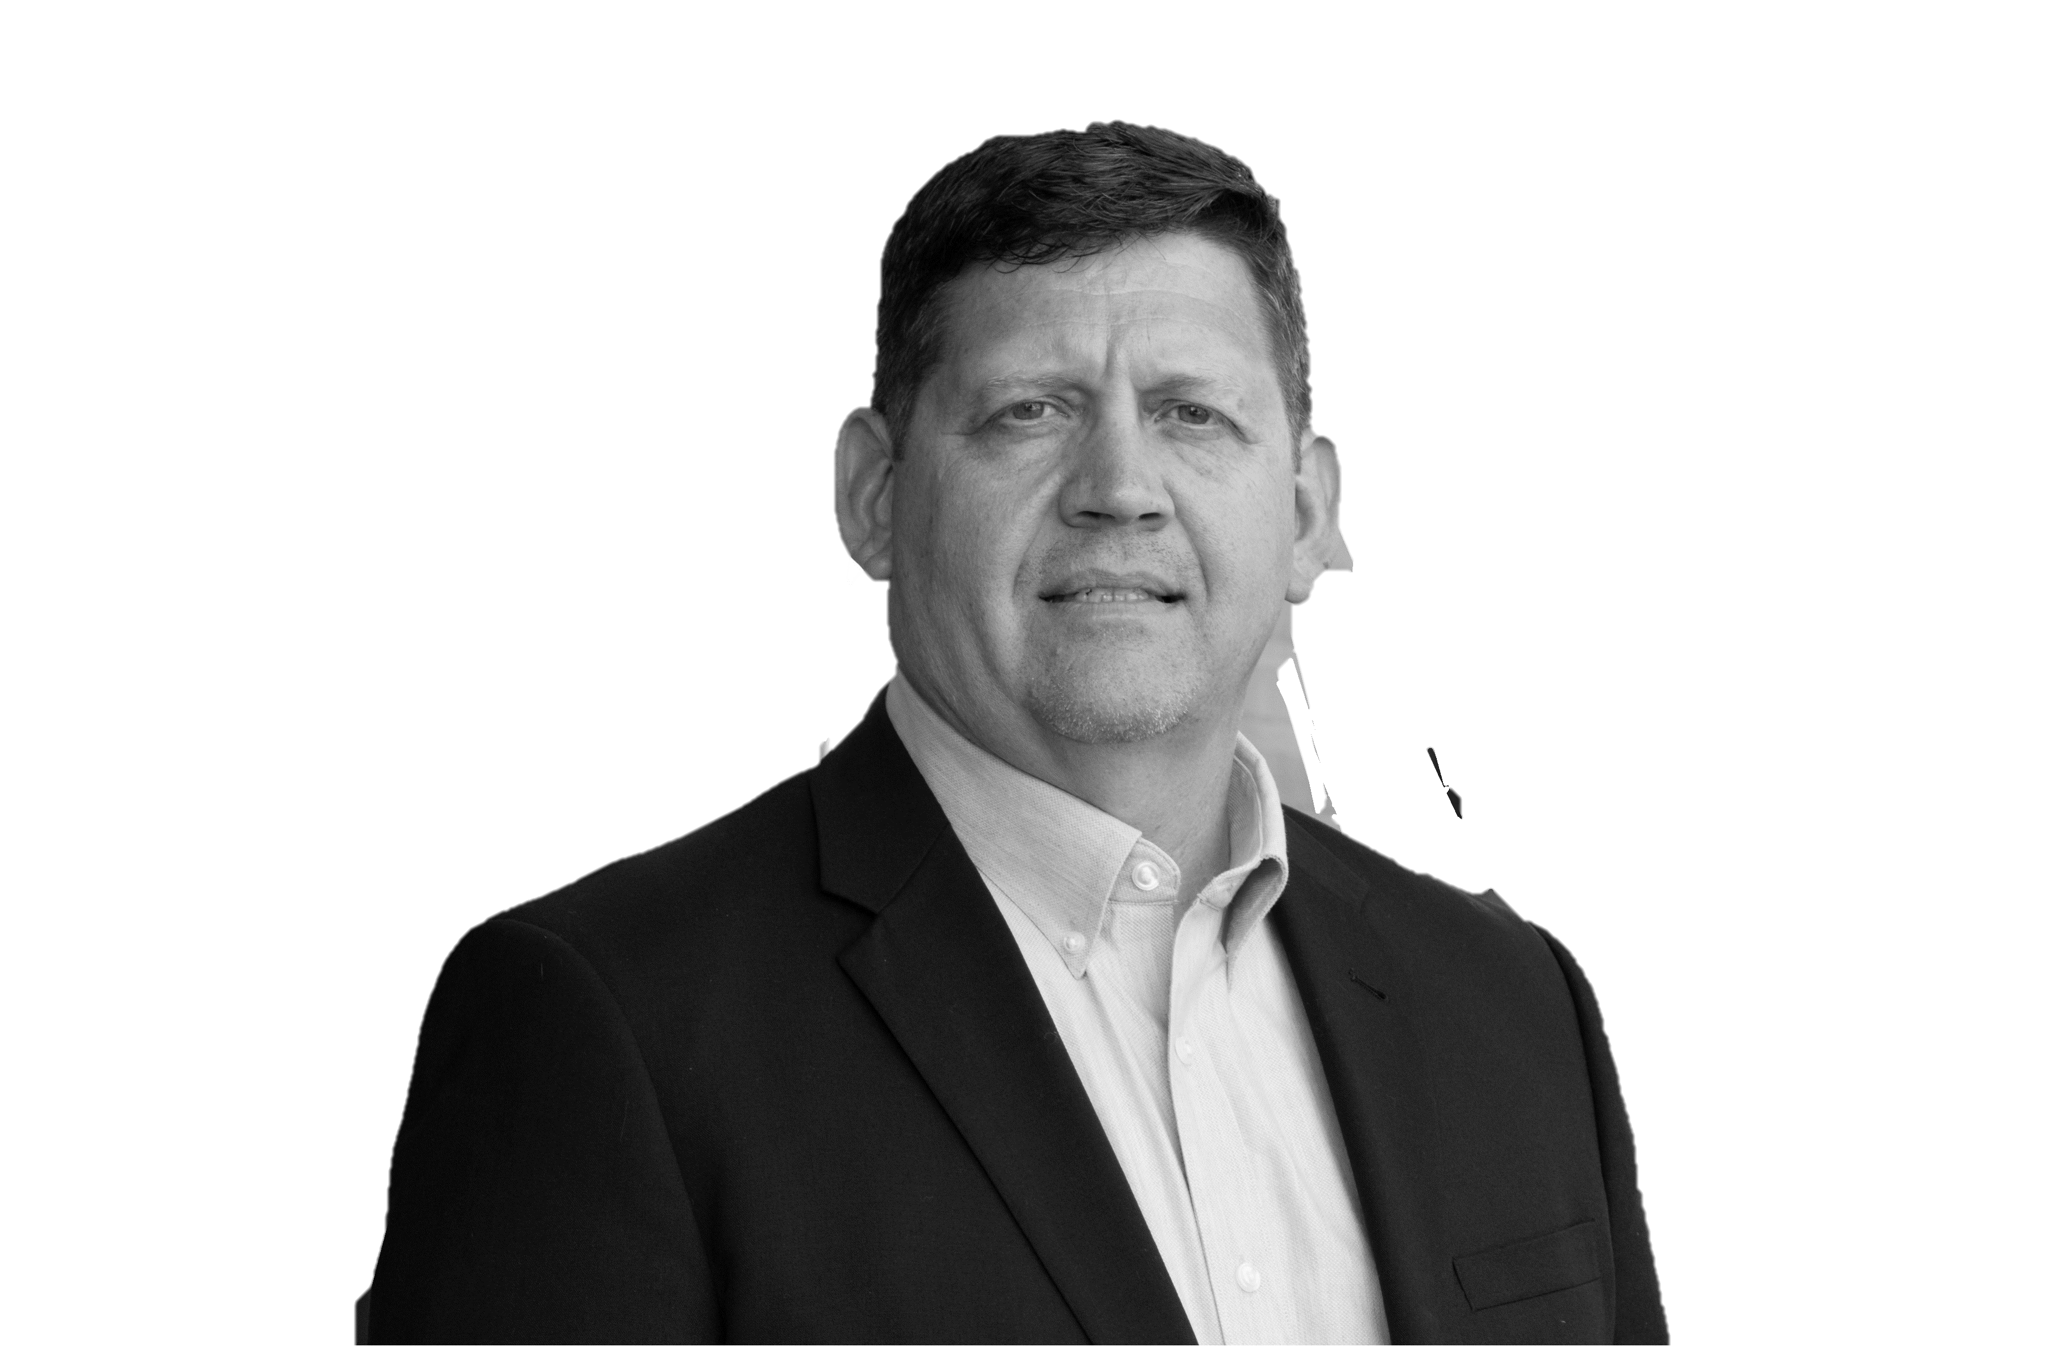
FACILITY PLANNING TEAM
Brian Crawford
Chief Operating Officer
Connor Wohlenhaus
Project Developer
Russ Reiter
K-12 Ambassador

Slide 3
WHERE WE HAVE BEEN
November 5th, 2024
November 18th, 2024
November 18th, 2024
December 6th, 2024
February 11th, 2025
March 12th, 2025
Initial Kickoff Meeting
Staff & Faculty Survey Sent Out
Initial Site Visit & Data Collection
Follow-Up Site Visit
Draft Report Review
Final Report Delivery & Presentation

Slide 4
WHERE WE ARE GOING
Prioritization & Planning
  Create budgets for identified improvement/maintenance needs
  Prioritize identified improvements
  Create long term facility maintenance & master plan
When: Spring-Summer 2025

Slide 5
YOUR ROLE
Understand existing conditions of your facilities
Understand staff survey feedback
Actively engage in conversation
Set trajectory for large and small facility improvements
GOAL FOR TONIGHT: understand & identify facility maintenance priorities for each facility

Slide 6
ASSESSMENT METHODOLOGY
Divide facility into three sections based on grades served (elementary, middle school, high school)
Itemize & categorize building “assets” and assign visual grade and age
Weigh asset with rough-order-magnitude replacement cost
Compare asset against expected life (BOMA standard)

Slide 7
ASSESSMENT METHODOLOGY

Slide 8
ASSET CATEGORIES
Interiors
  Ceiling, Flooring, Casework, Walls, Interior Doors, Furniture, Capital Equipment, etc.
Exteriors
  Roofing, Masonry/Siding, Windows, Doors, Sidewalks, Parking Lots, Playgrounds, etc.
Accessibility
  Americans with Disability Act (ADA) Items
Life Safety
  Fire alarm, Fire suppression, Secure Entry, Emergency Lighting, etc.
Mechanical
  HVAC, Piping, Ductwork, Temperature Controls, etc.
Plumbing
  Plumbing Fixtures, Water Heaters, Piping, etc.
Electrical
  Electrical Distribution, Electrical Switchgear, Lighting, etc.
Technology
  Cabling Systems, Phone System, Video Surveillance, etc.

Slide 9
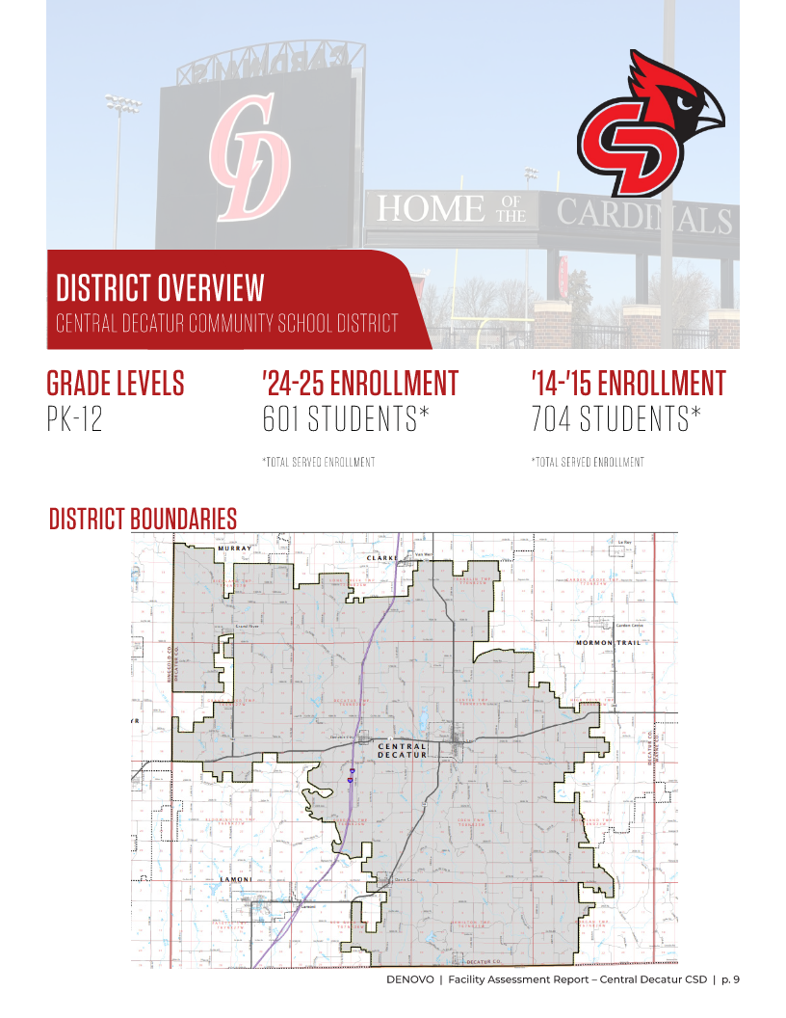
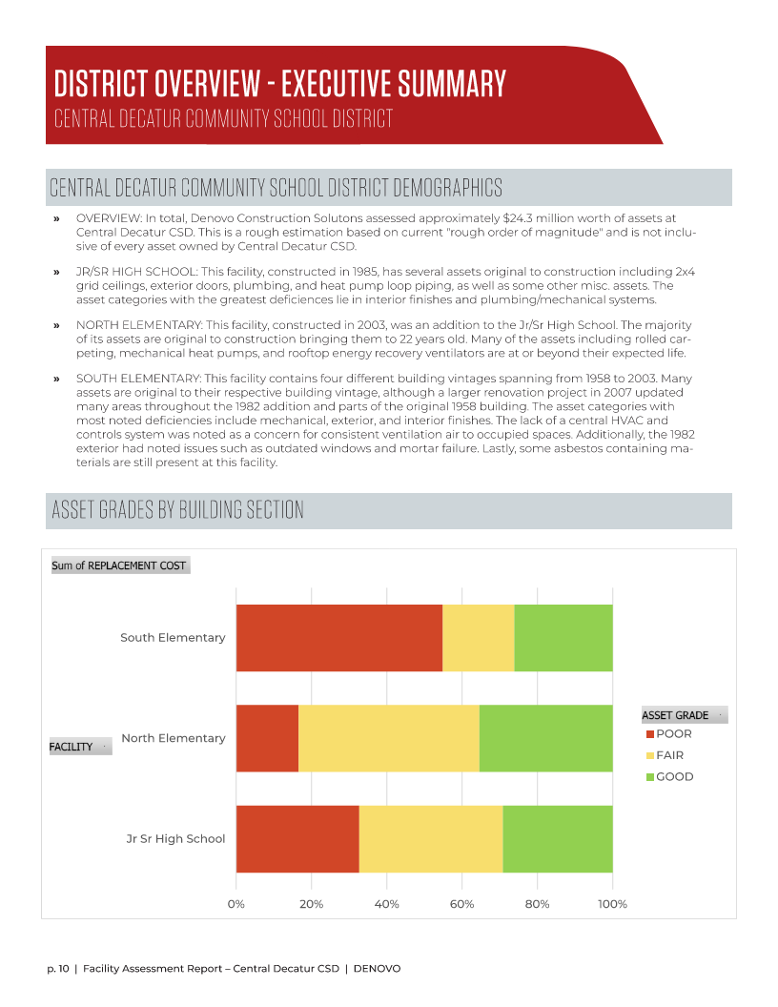

Slide 10
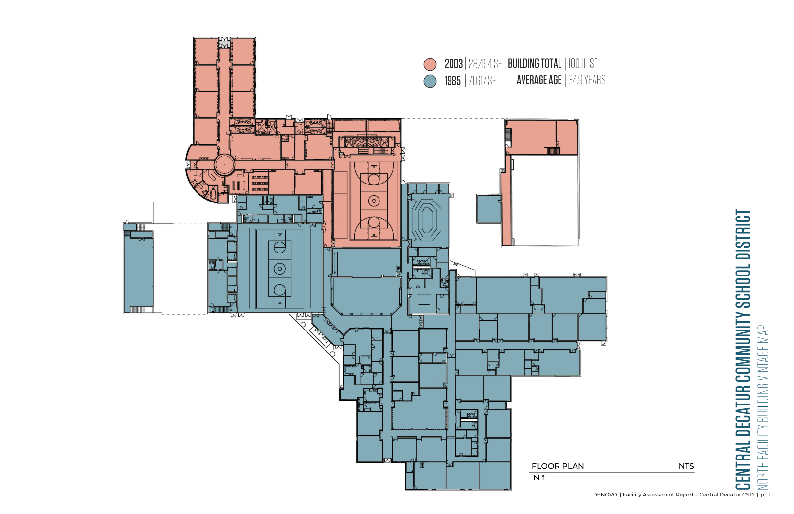

Slide 11
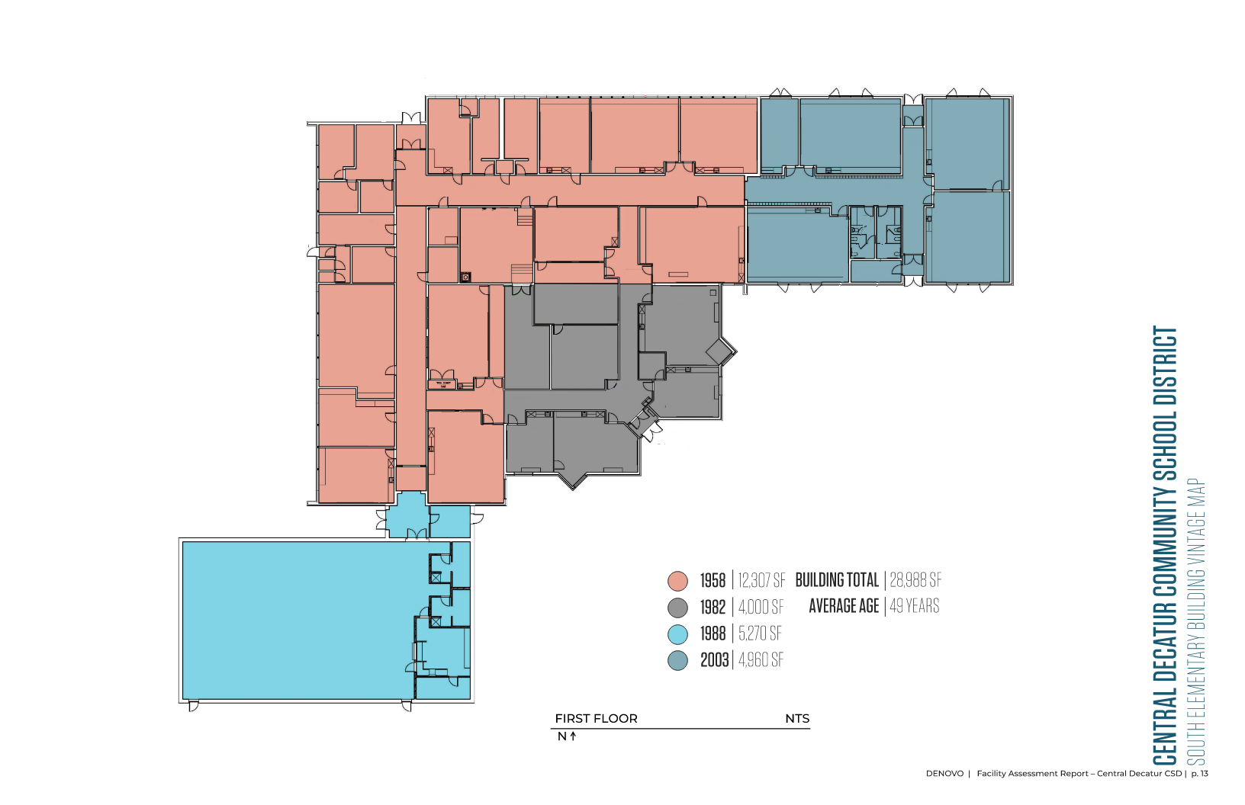

Slide 12
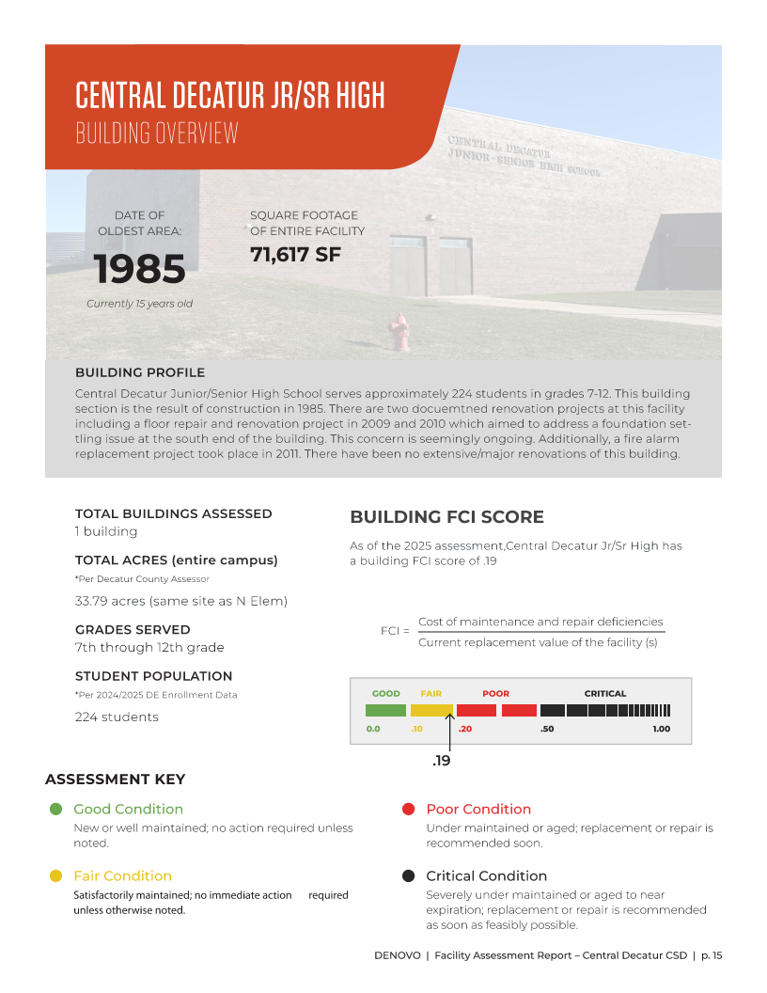
JR/SR HIGH OVERVIEW
FCI Score: 0.19
Aging interior finishes throughout
Several original exterior doors incl. main entry vestibule
Ongoing settling & heaving at south/southeast corner
Several mechanical system components beyond life expectancy: (10) heat pumps, heat exchanger, heat pump loop pumps
Notes:
Exterior doors (main entry vestibule)
“how do we take care of what we have”

Slide 13
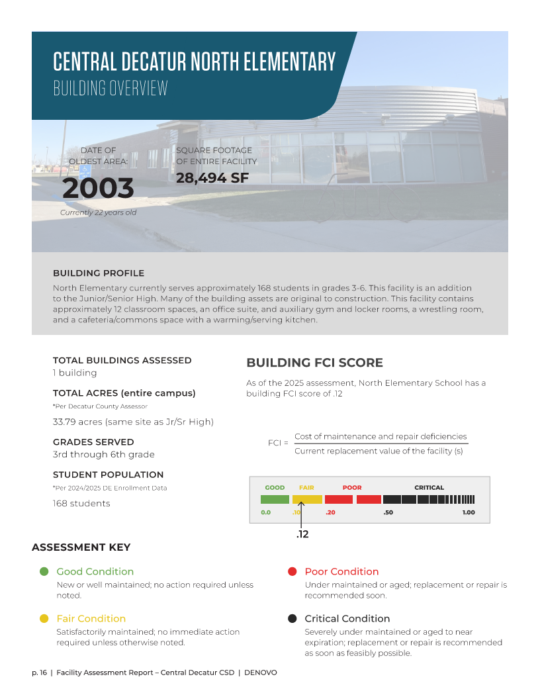
NORTH ELEMENTARY OVERVIEW
FCI Score: 0.12
Epoxy flooring & Rolled Carpeting aging
Original playground, wood chips wash away
Heat pumps & ERVs are at the end of their typical life
Fluorescent lighting

Slide 14
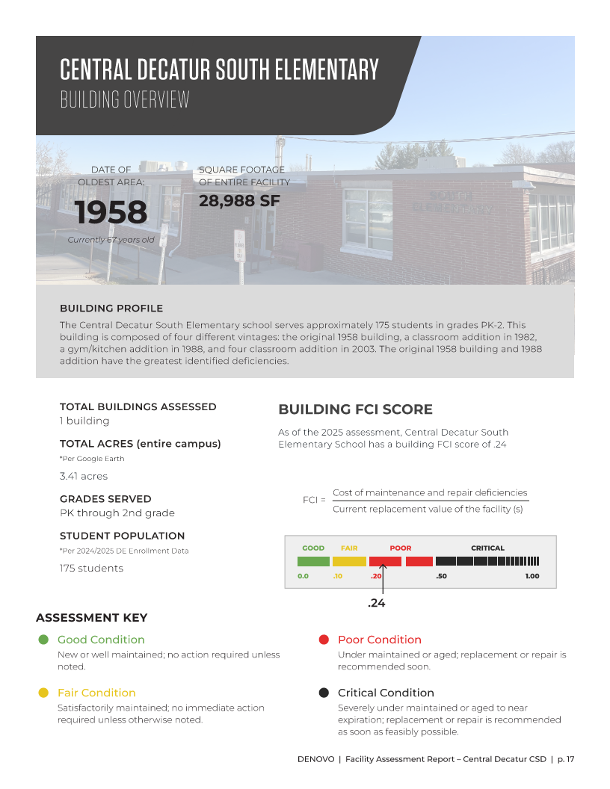
SOUTH ELEMENTARY OVERVIEW
FCI Score: 0.24
Some aging interior finishes
South façade brickwork (1982)
Playgrounds
Multiple HVAC systems “fighting” and aging equipment throughout

Slide 15
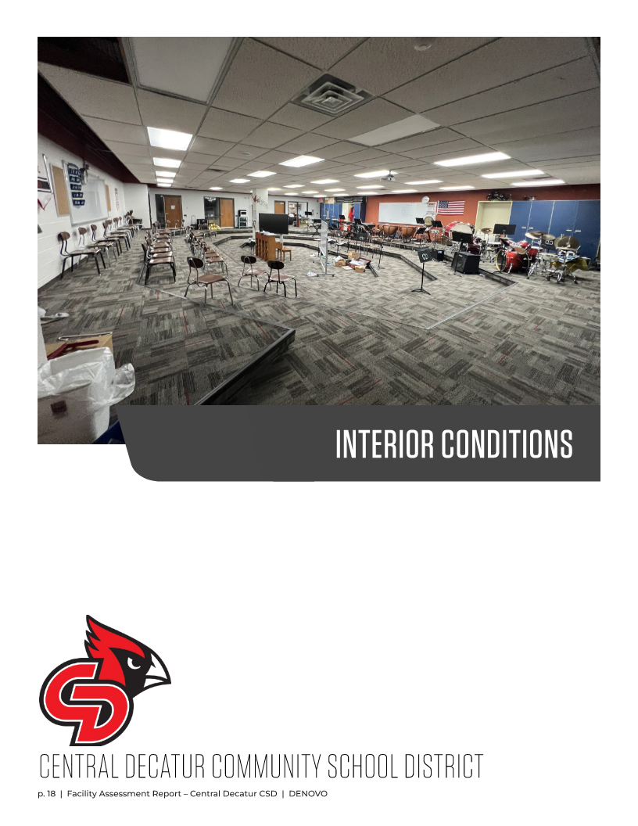

Slide 16
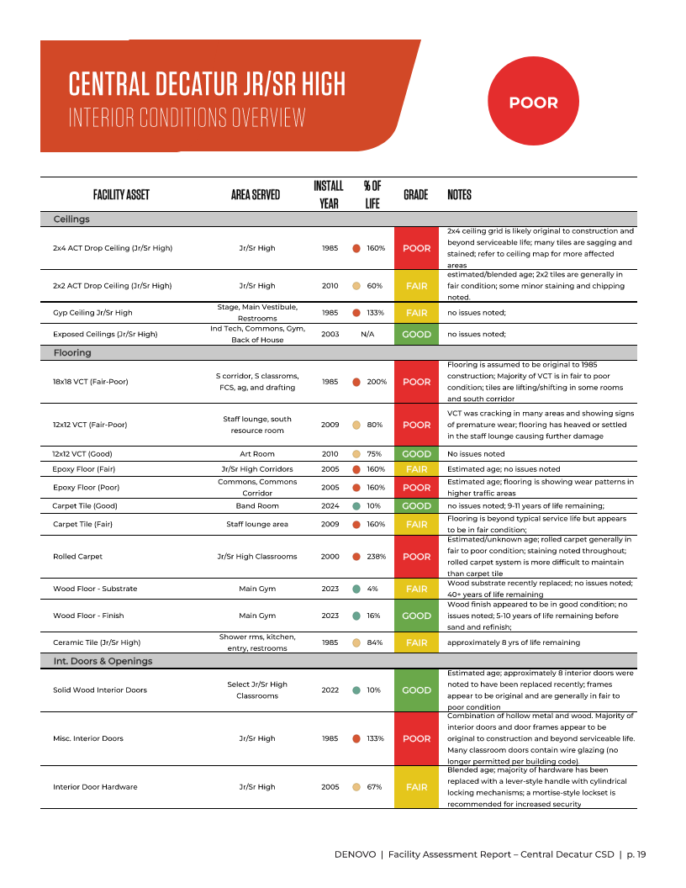
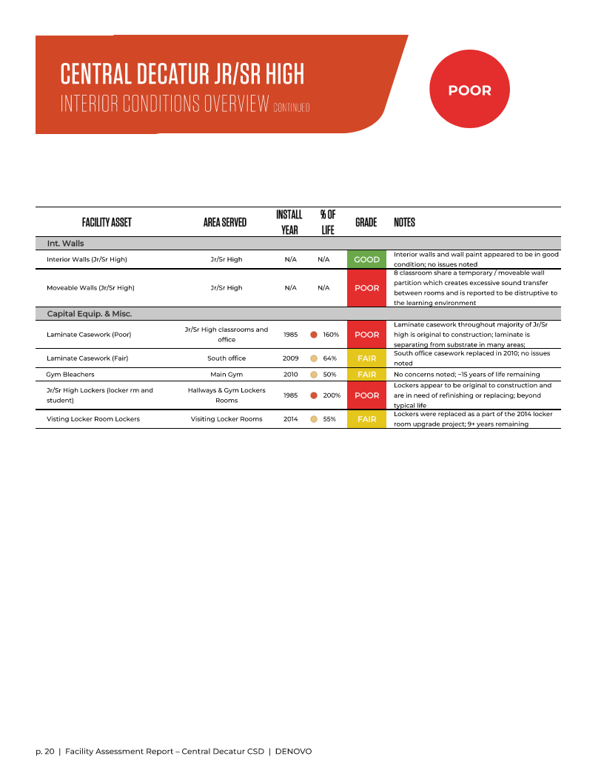

Slide 17
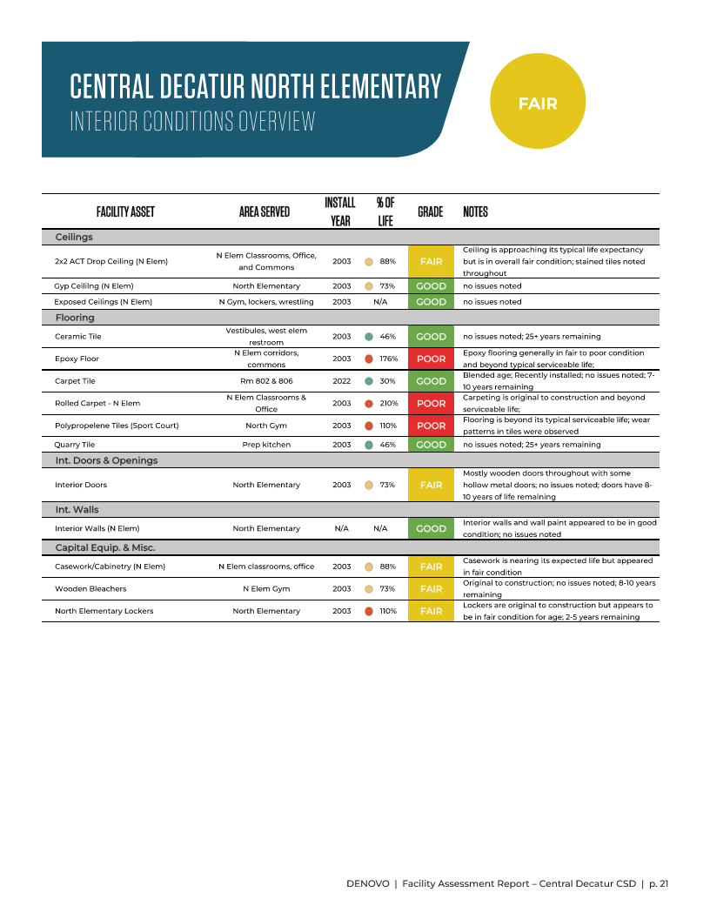

Slide 18
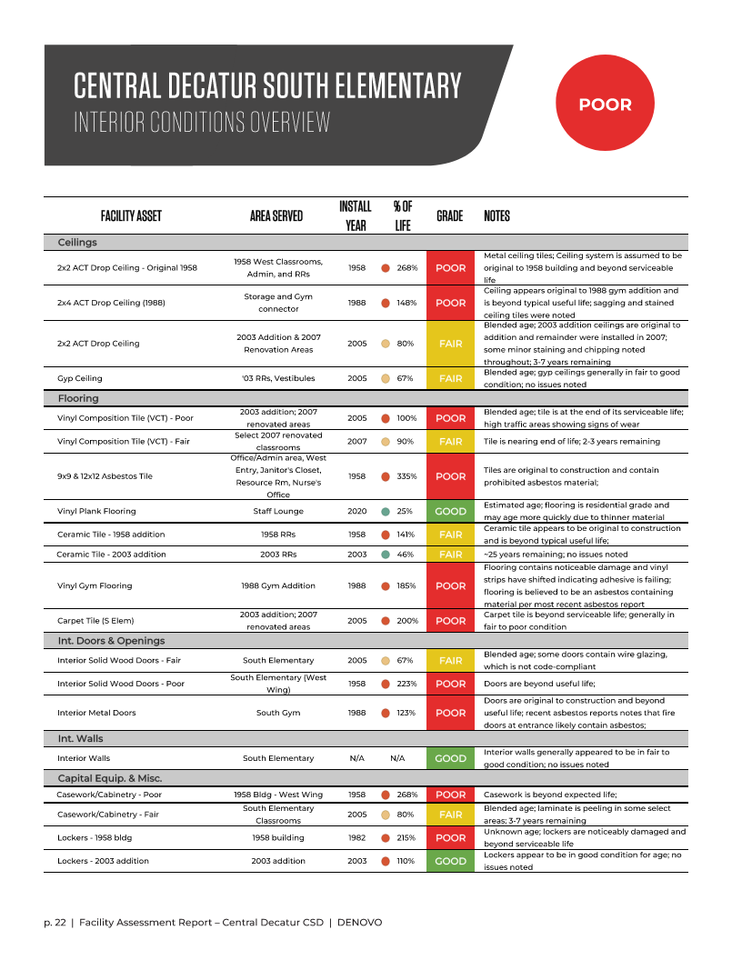

Slide 19
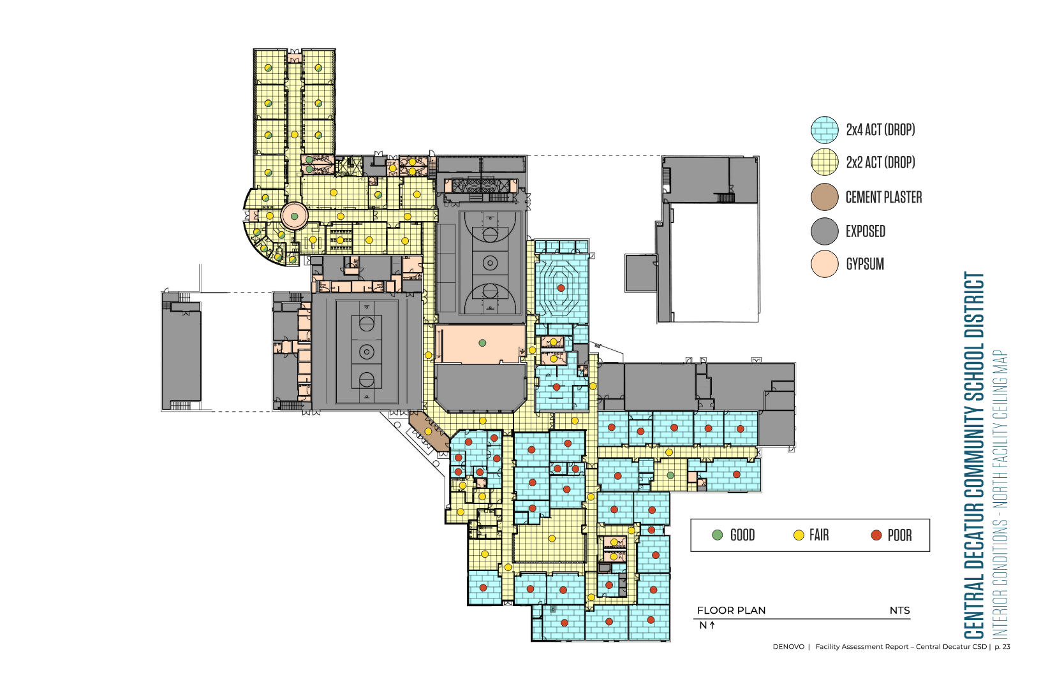

Slide 20
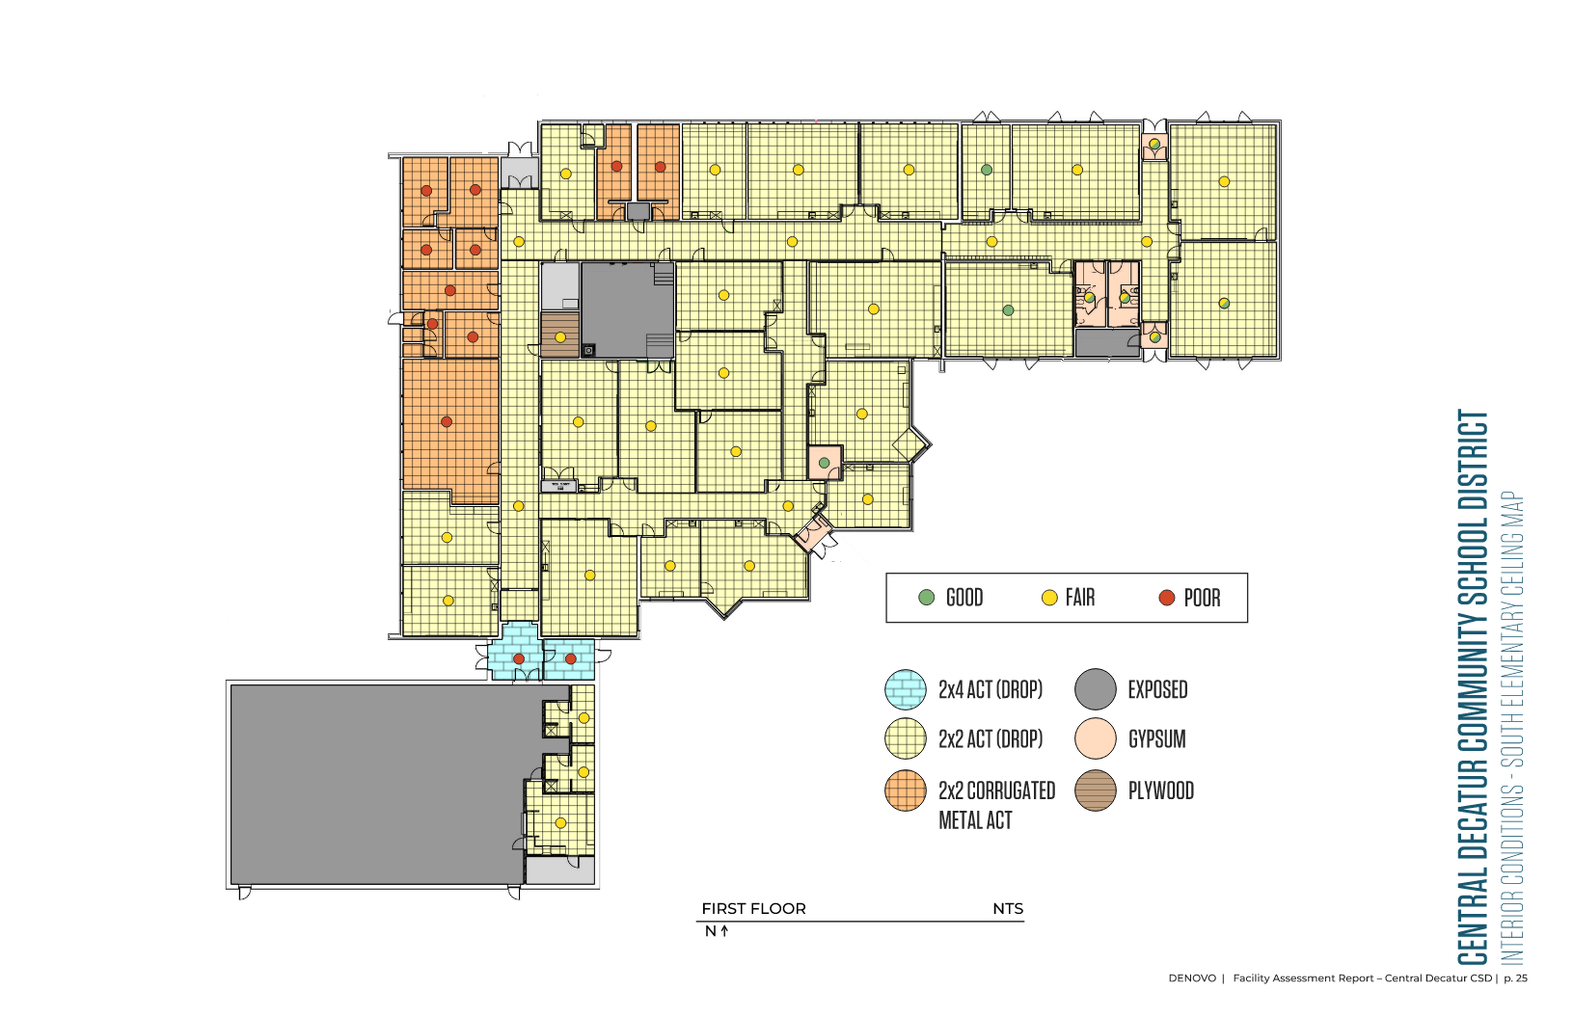

Slide 21
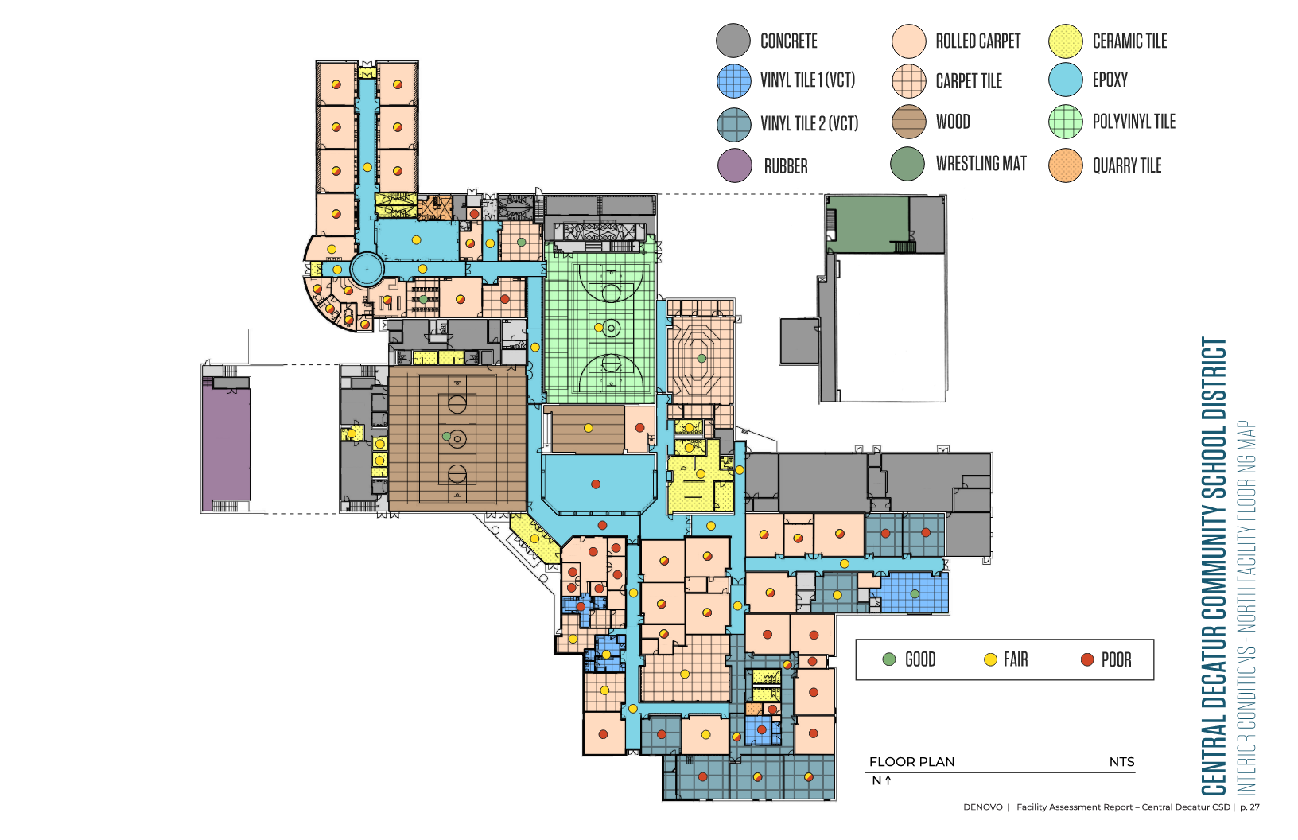

Slide 22
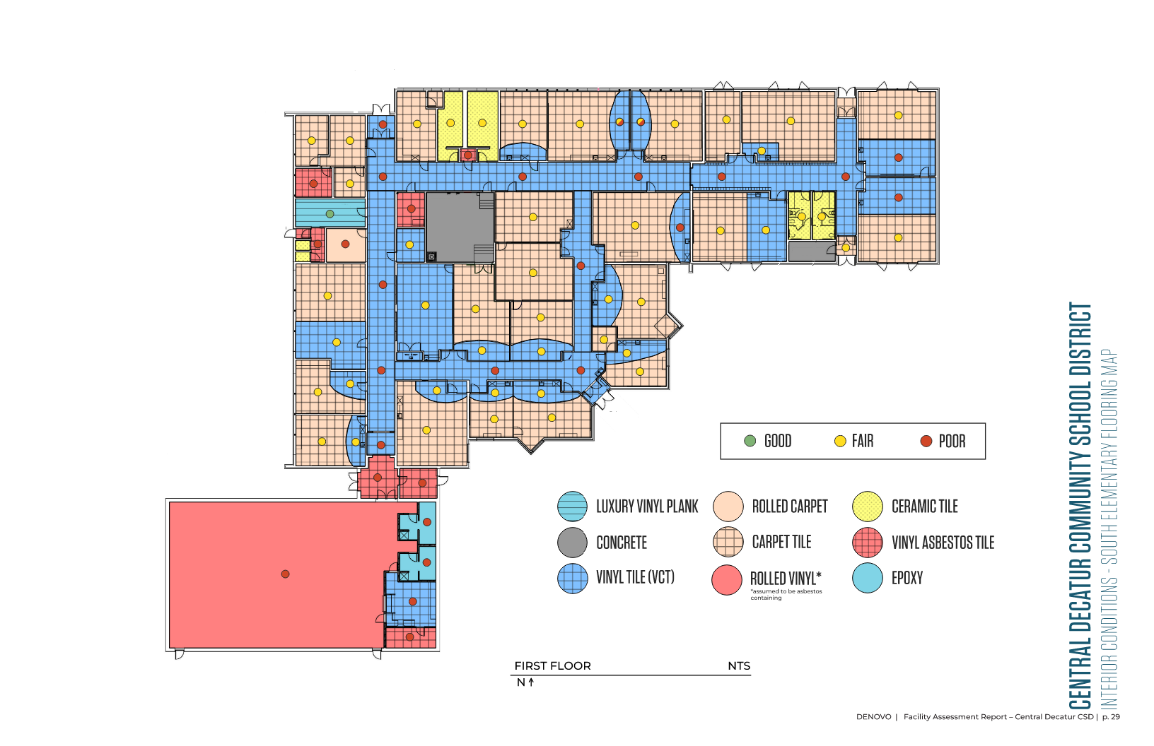

Slide 23
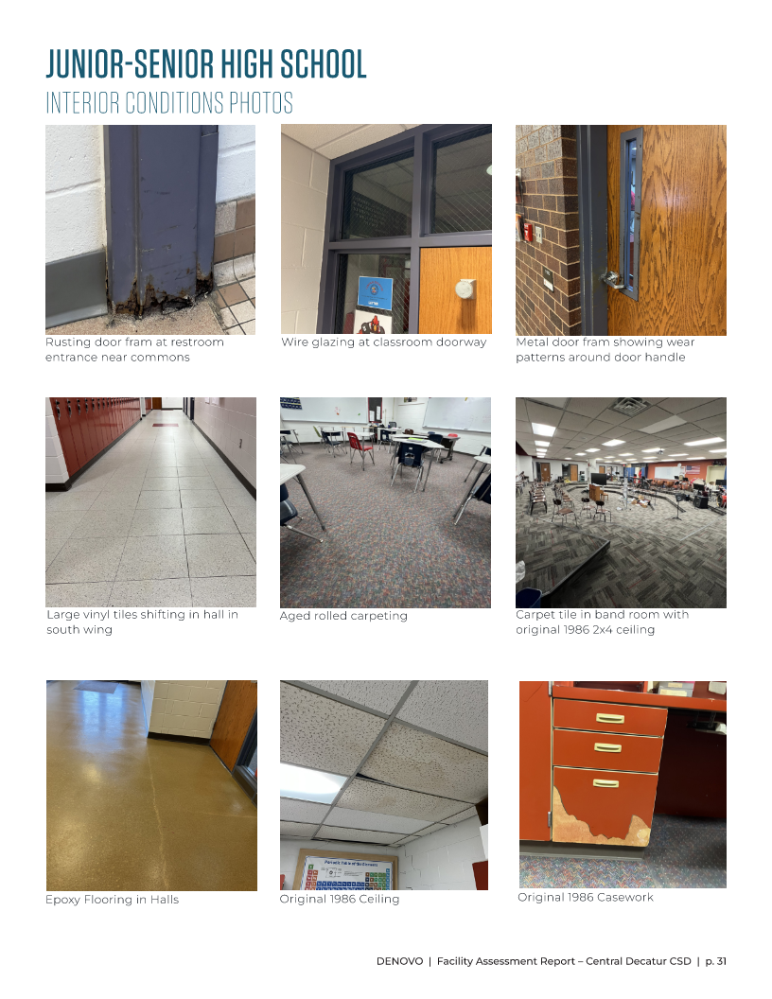

Slide 24
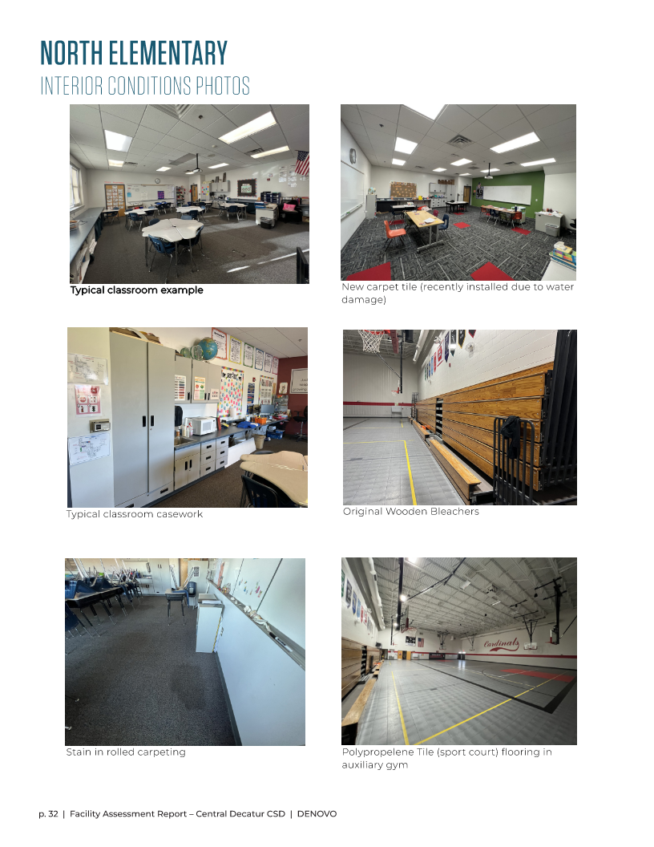

Slide 25
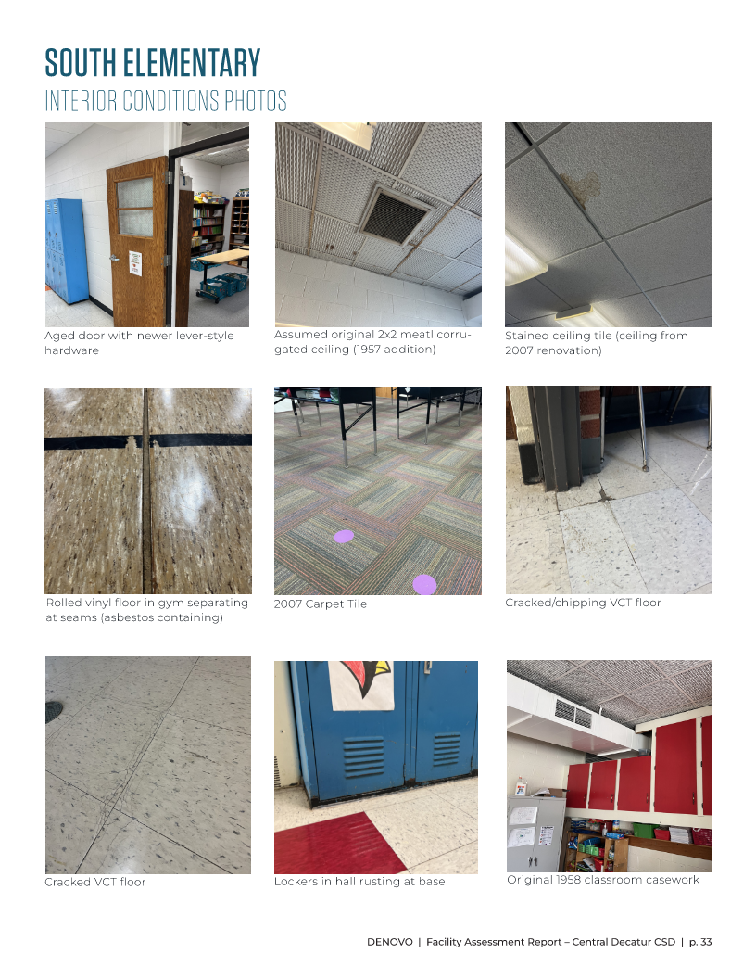

Slide 26
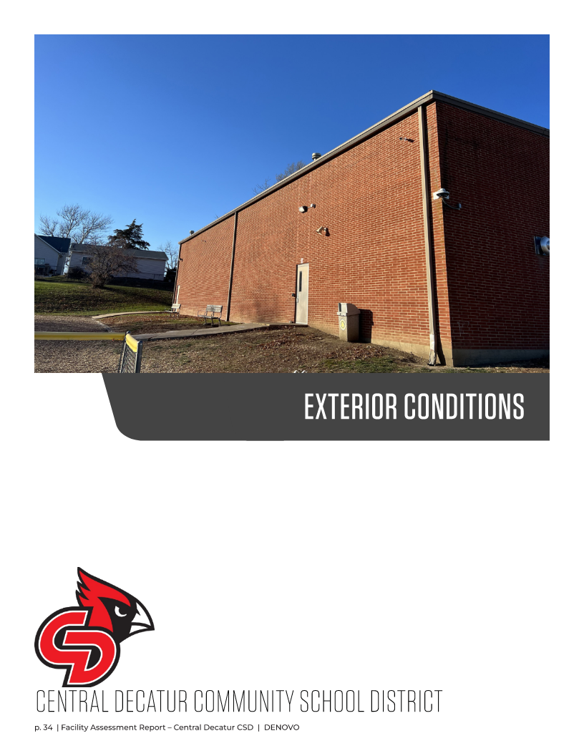

Slide 27
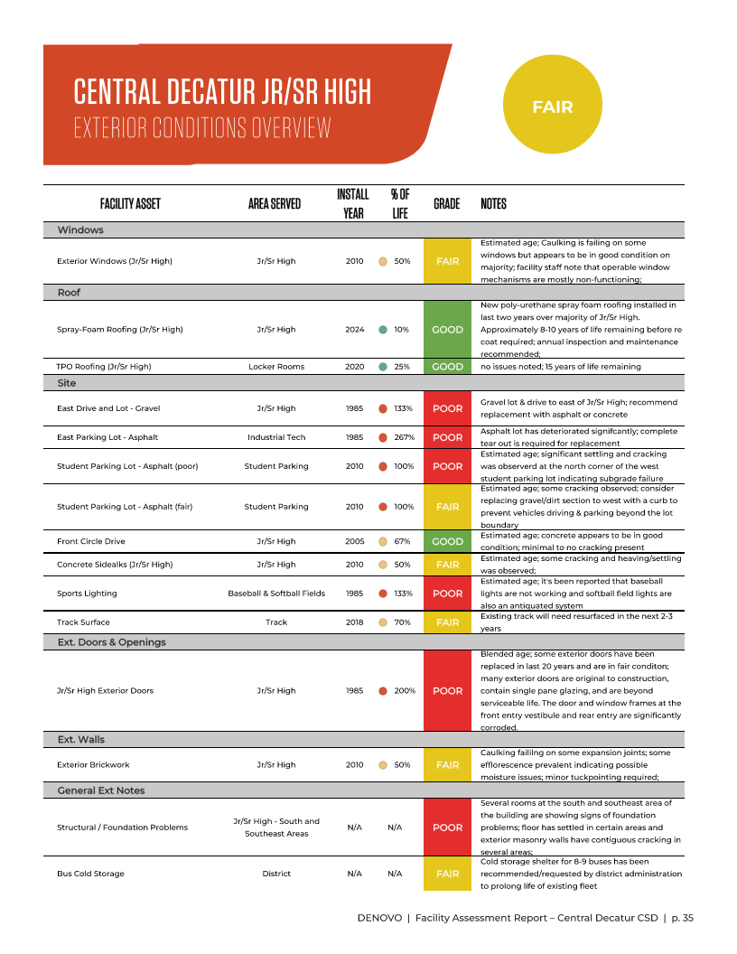

Slide 28
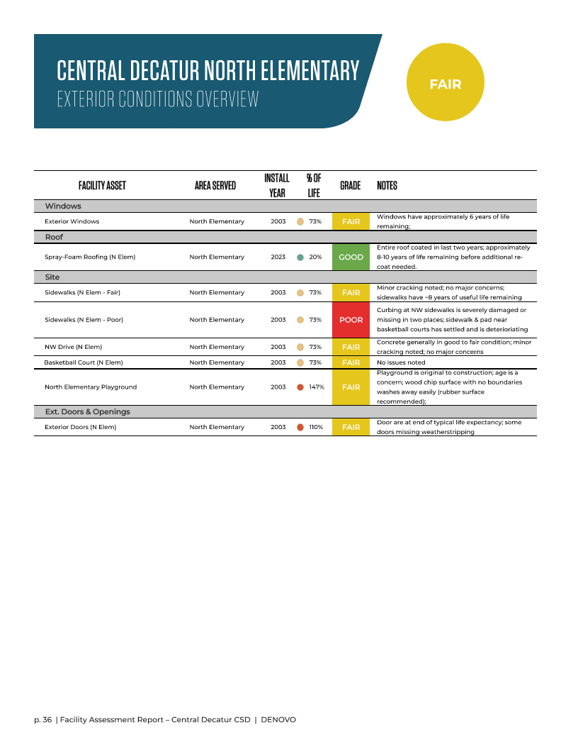

Slide 29
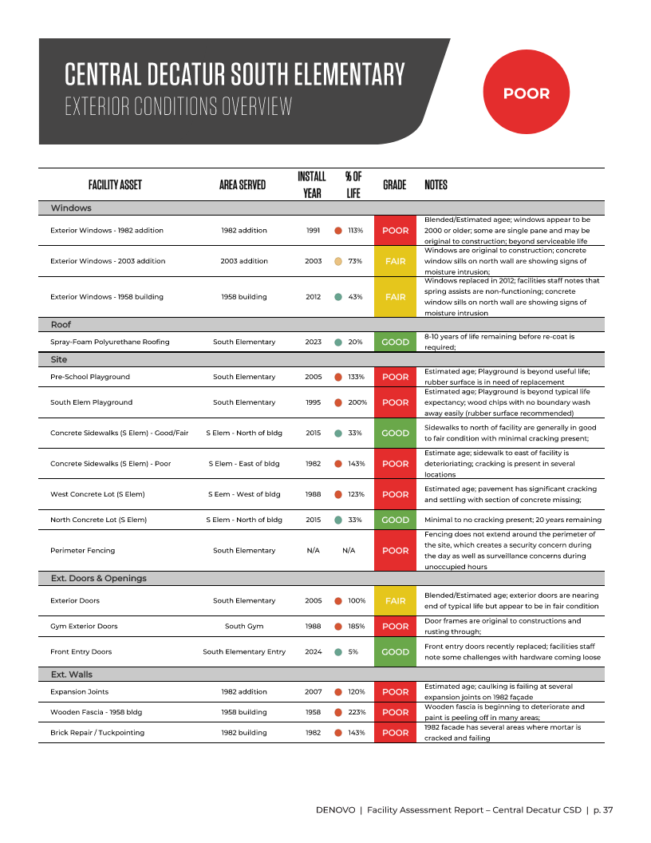

Slide 30
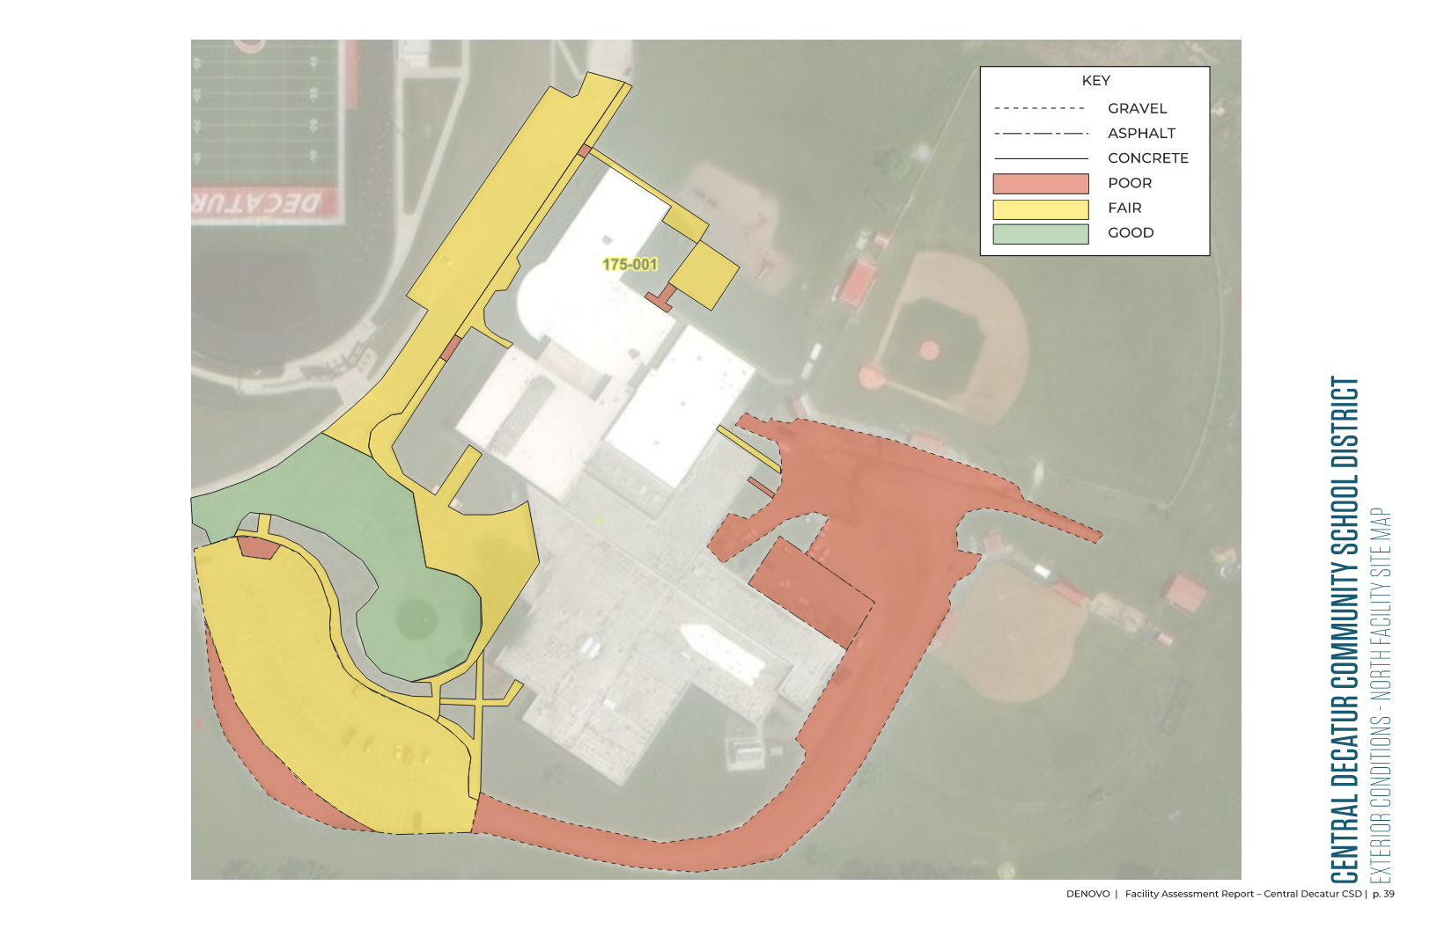

Slide 31
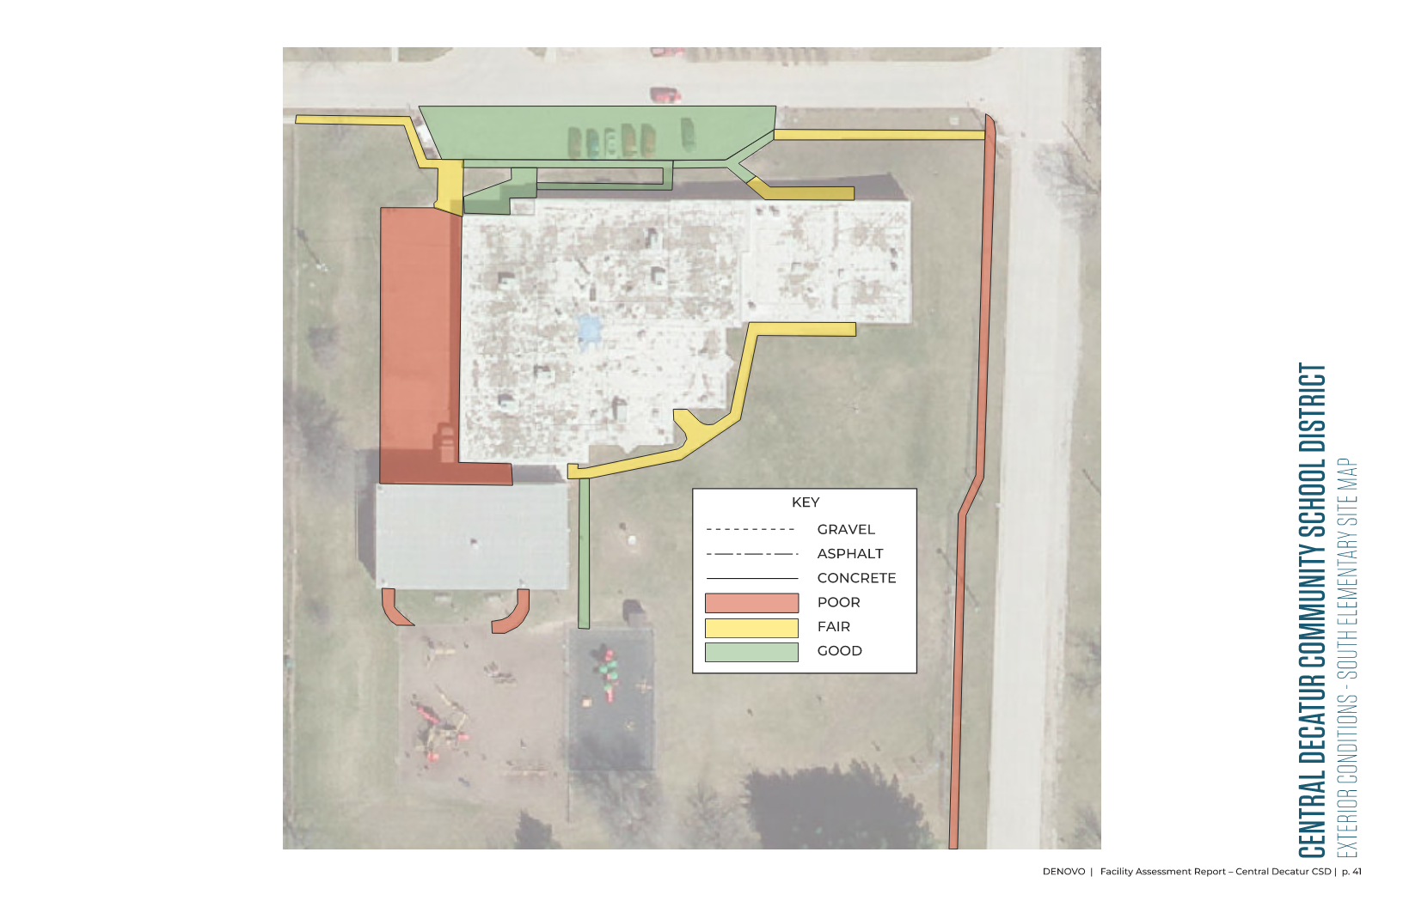

Slide 32
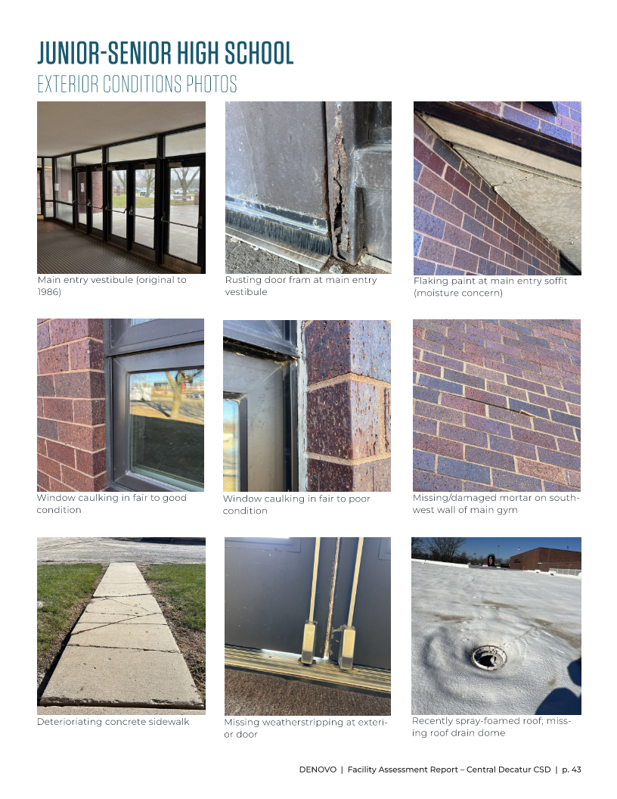
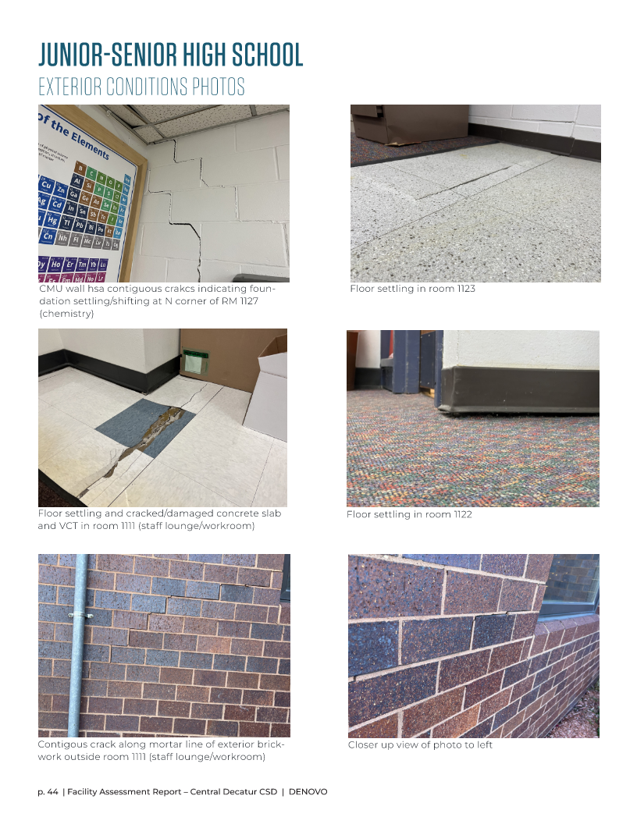

Slide 33
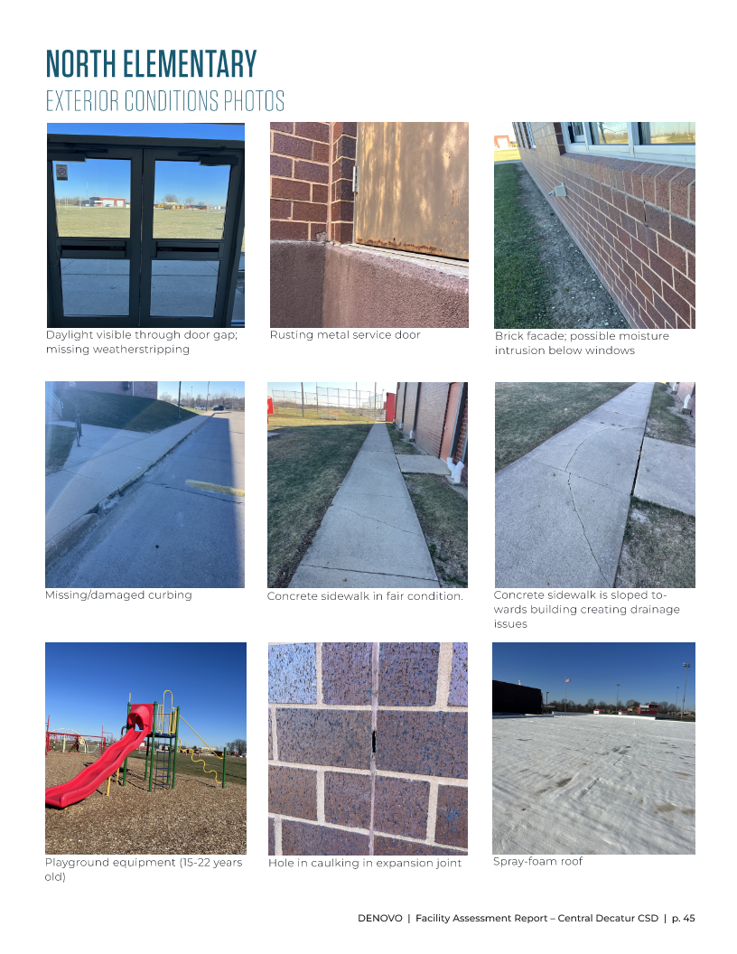

Slide 34
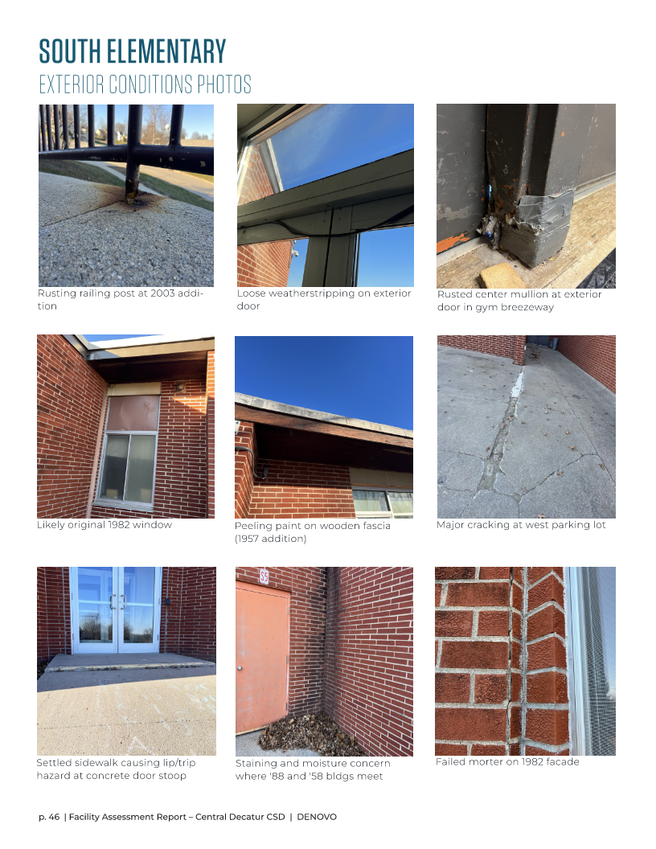

Slide 35
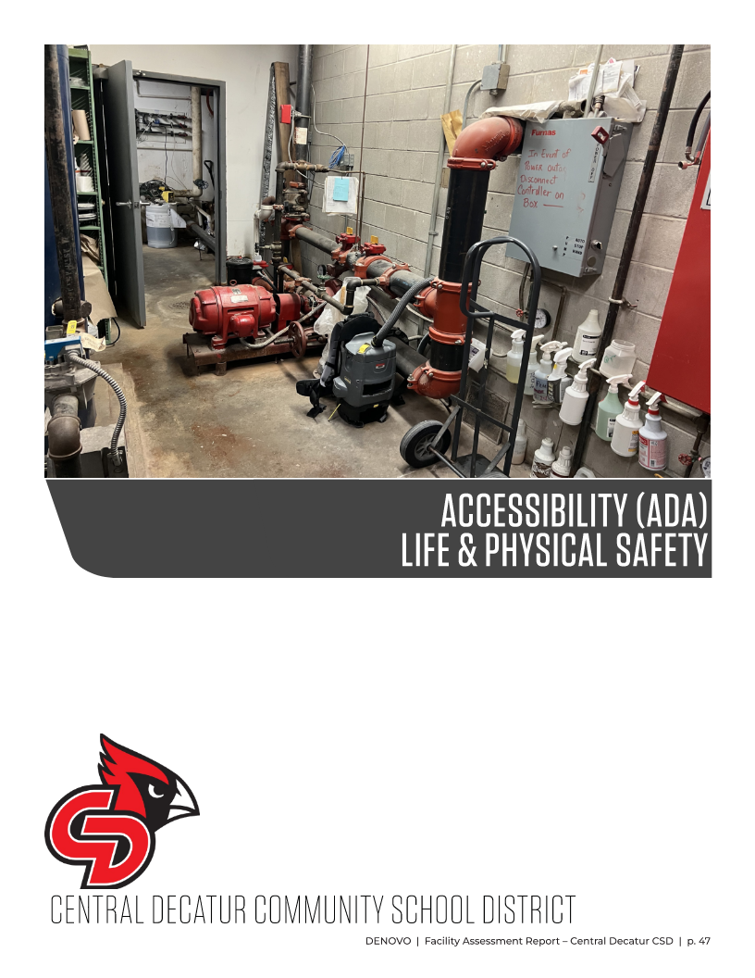

Slide 36
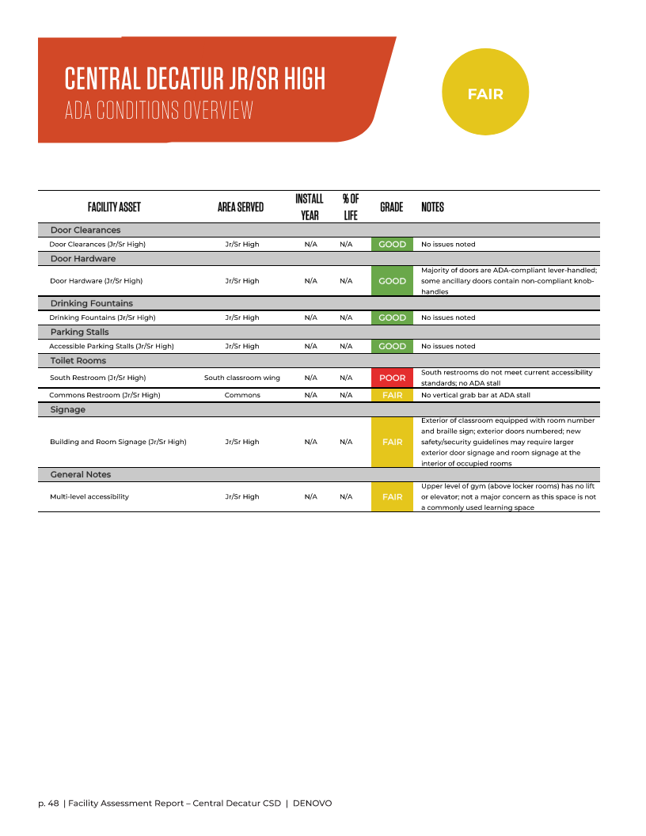
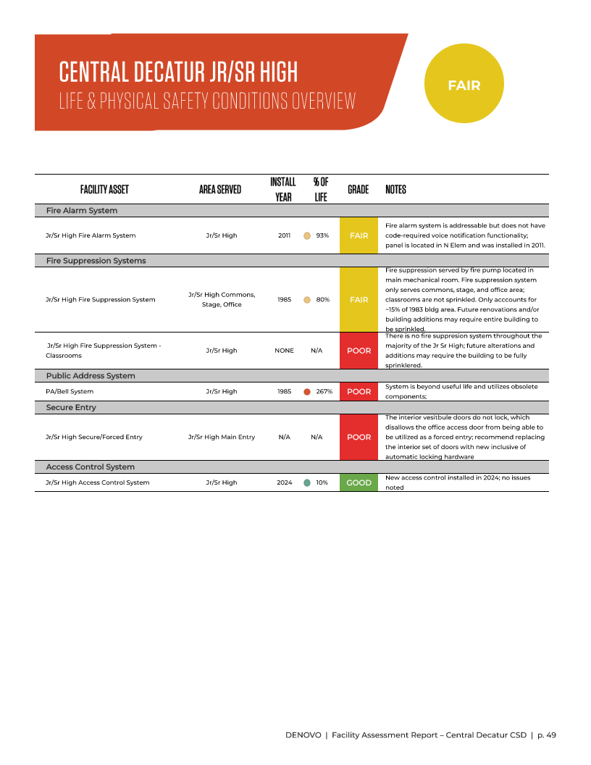

Slide 37
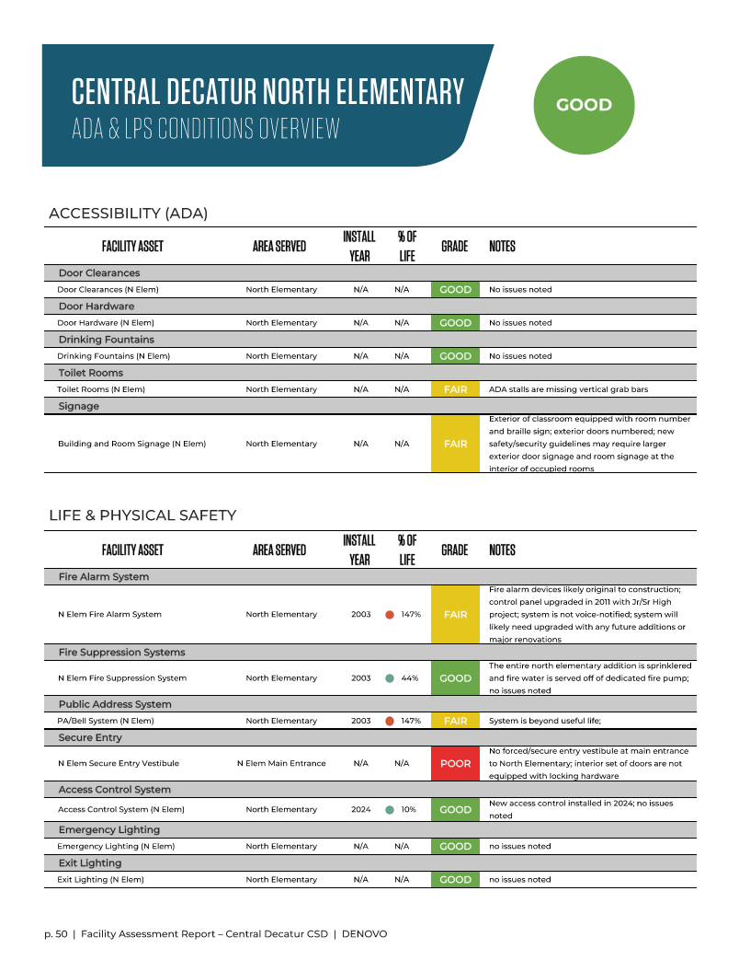

Slide 38
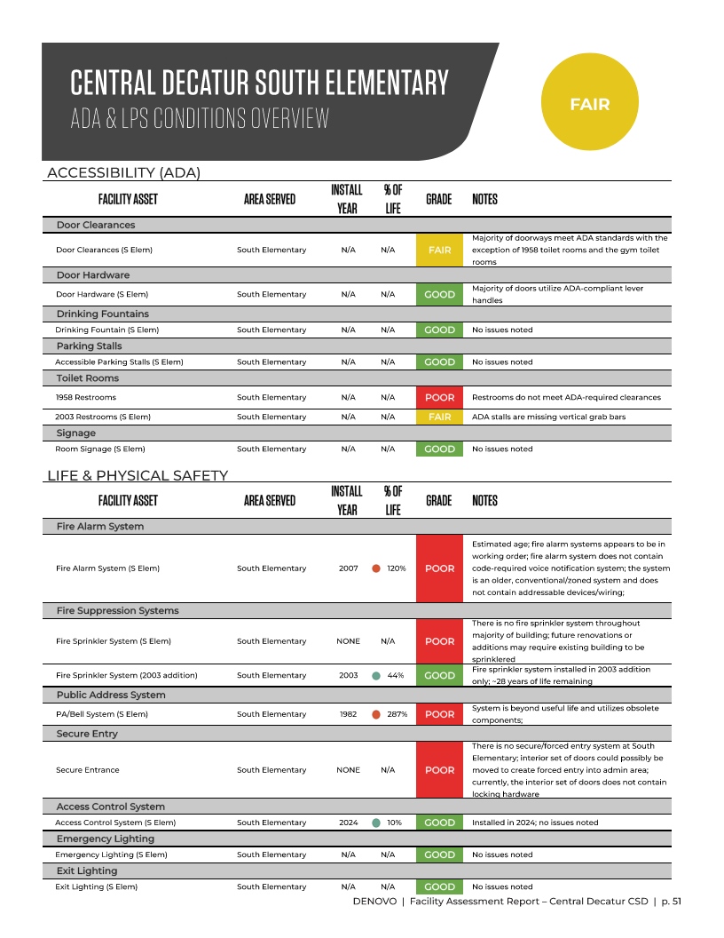

Slide 39
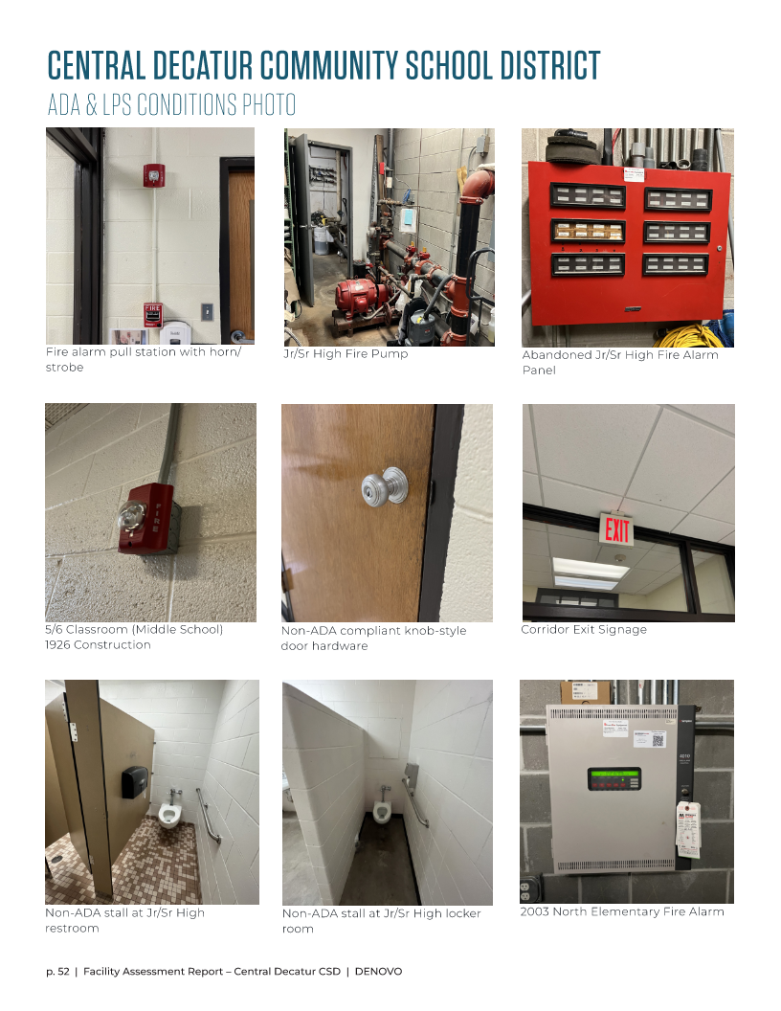

Slide 40
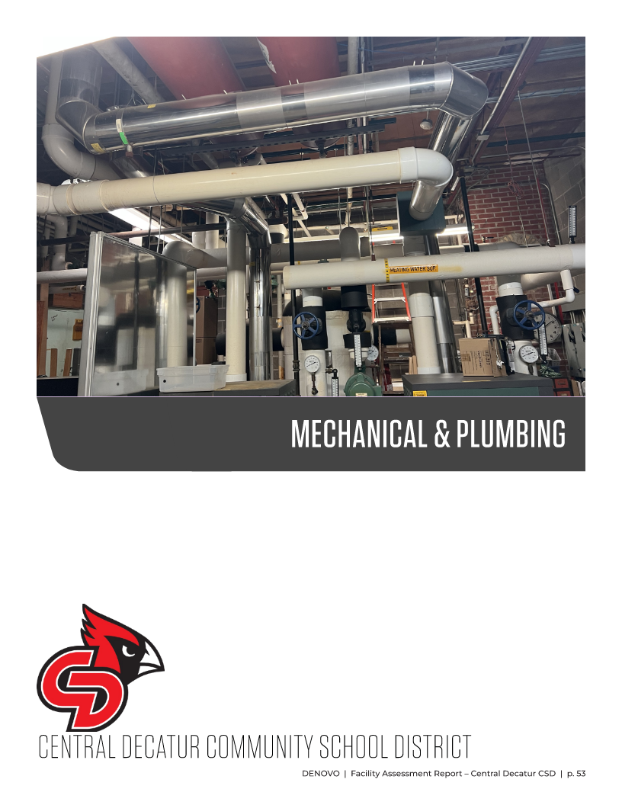

Slide 41
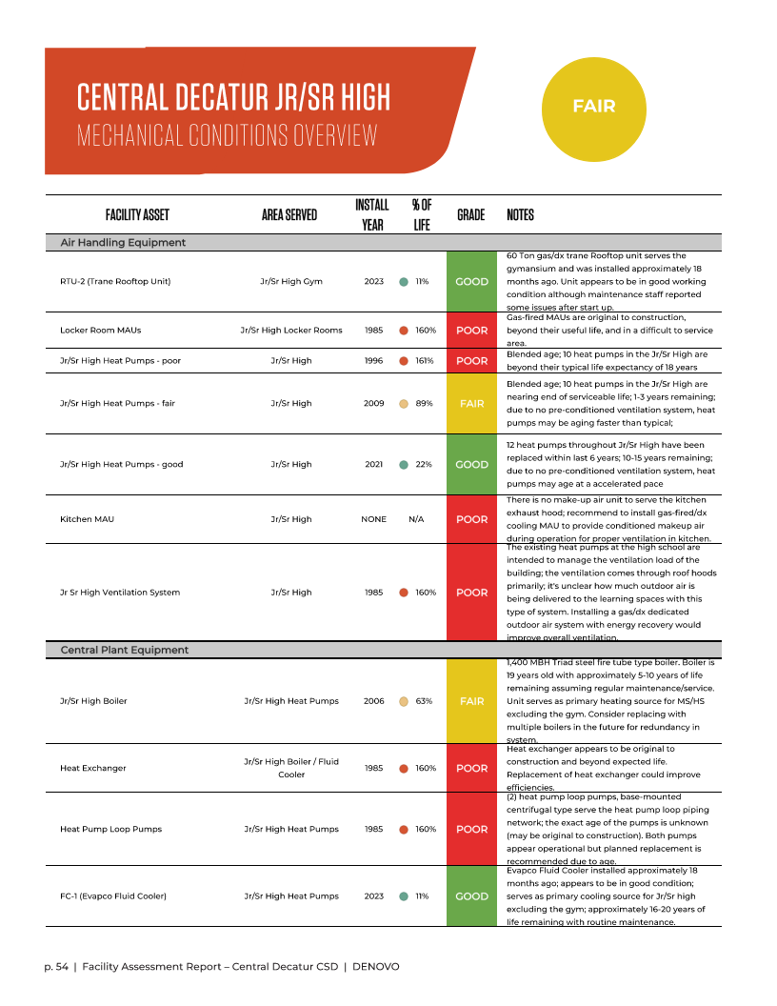
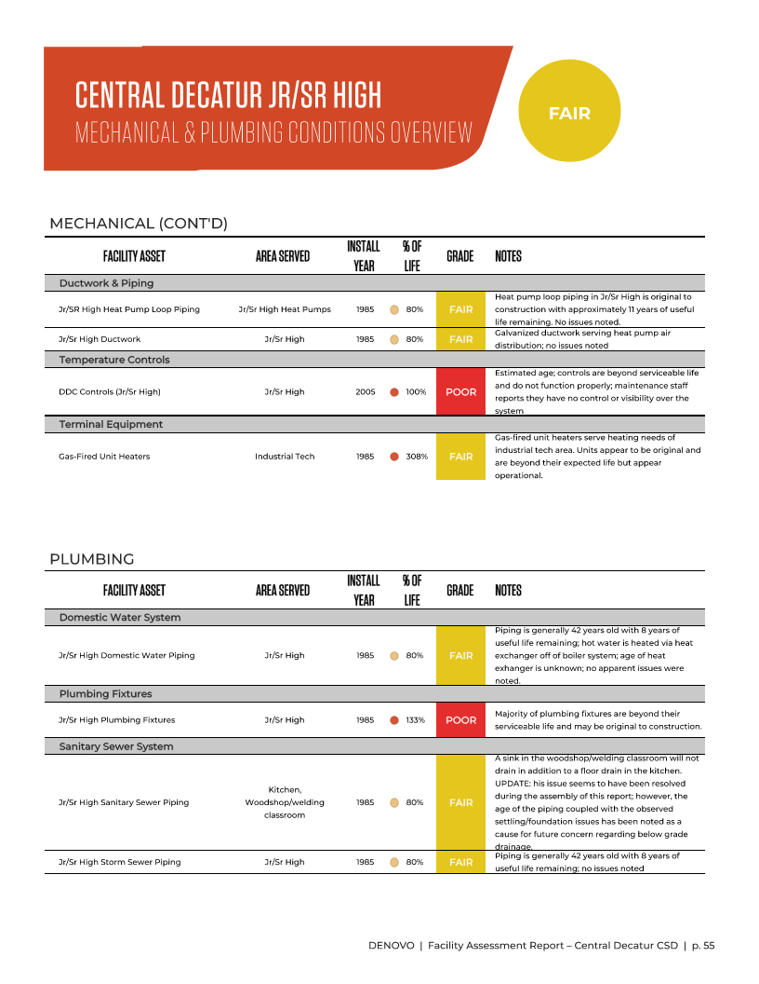

Slide 42
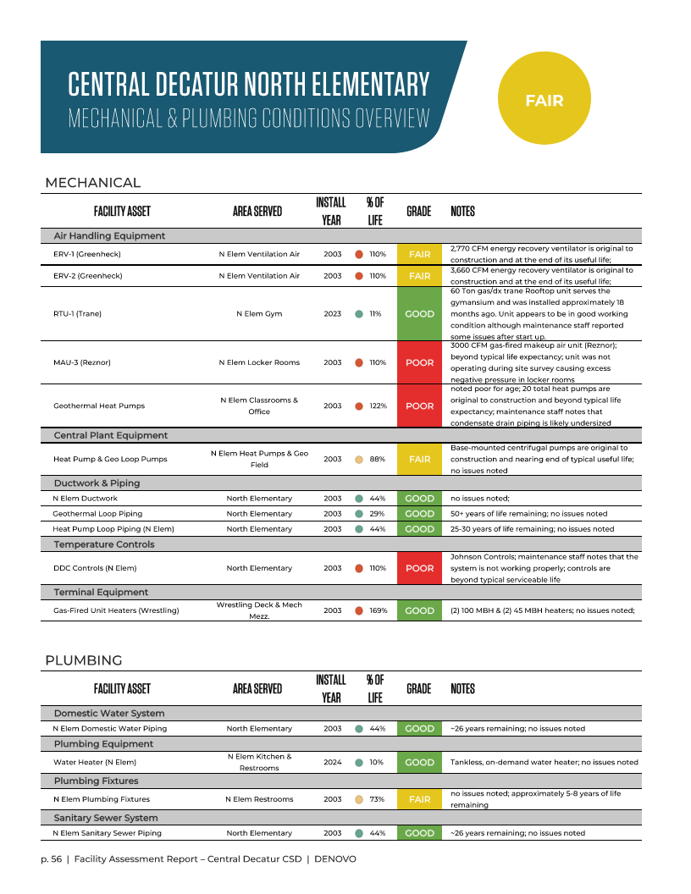

Slide 43
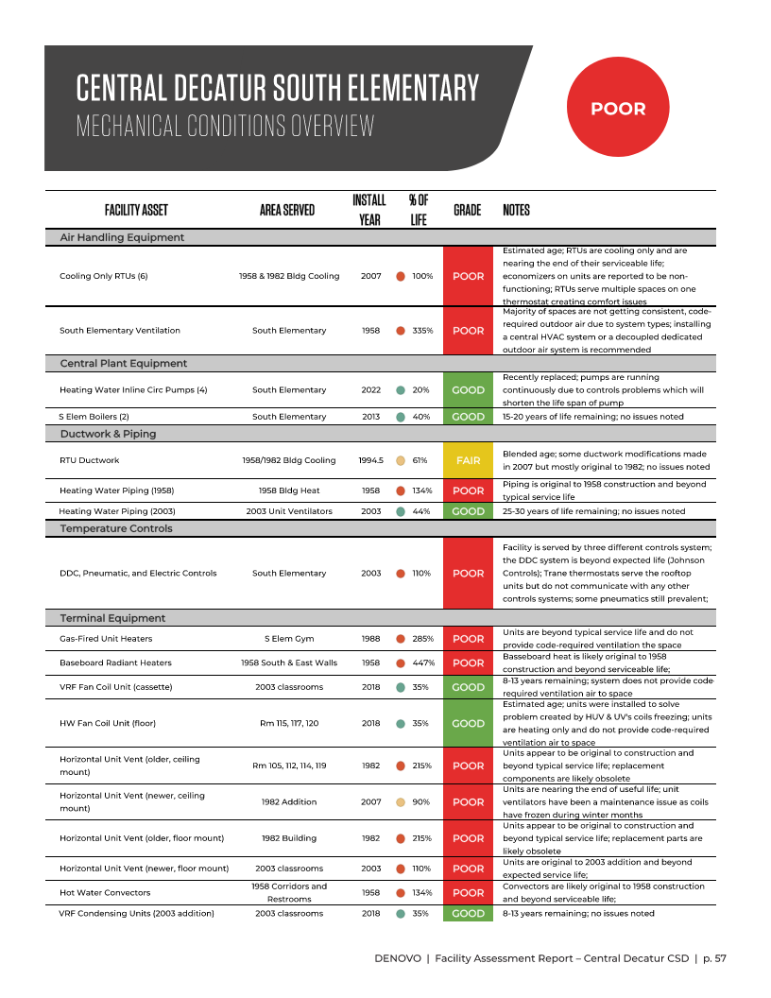
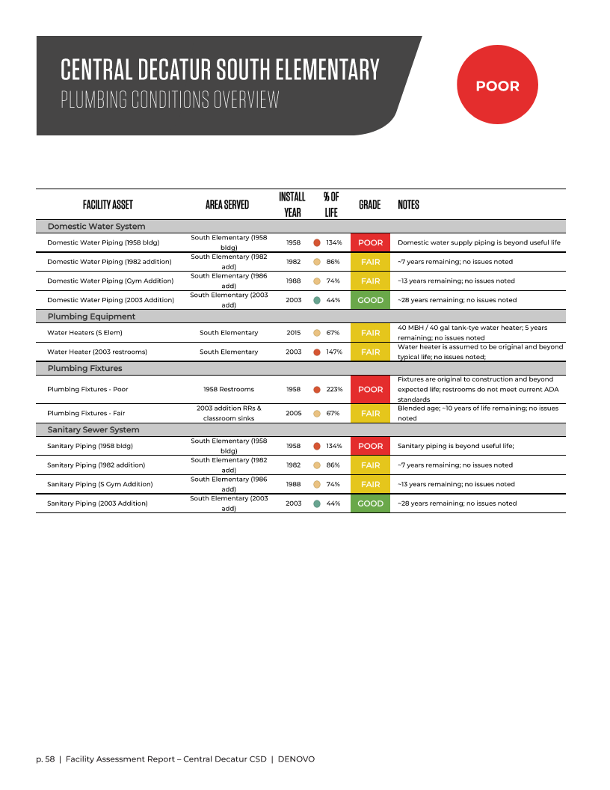

Slide 44
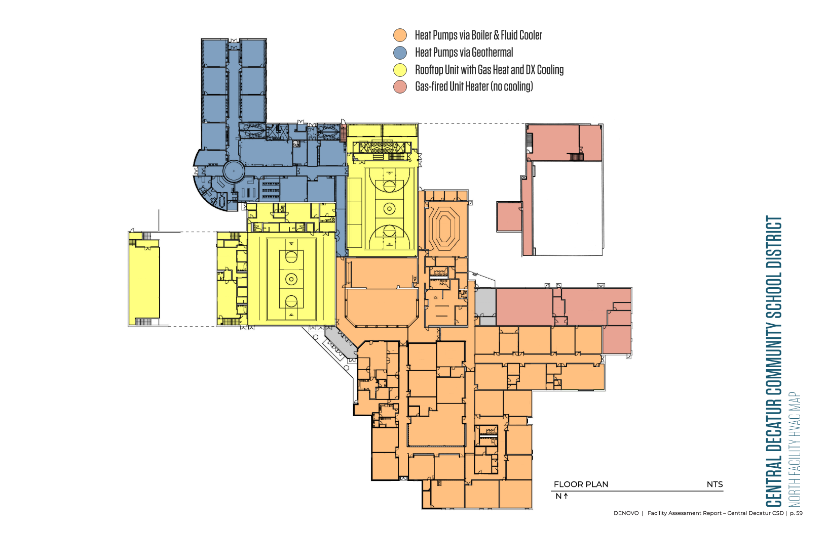

Slide 45
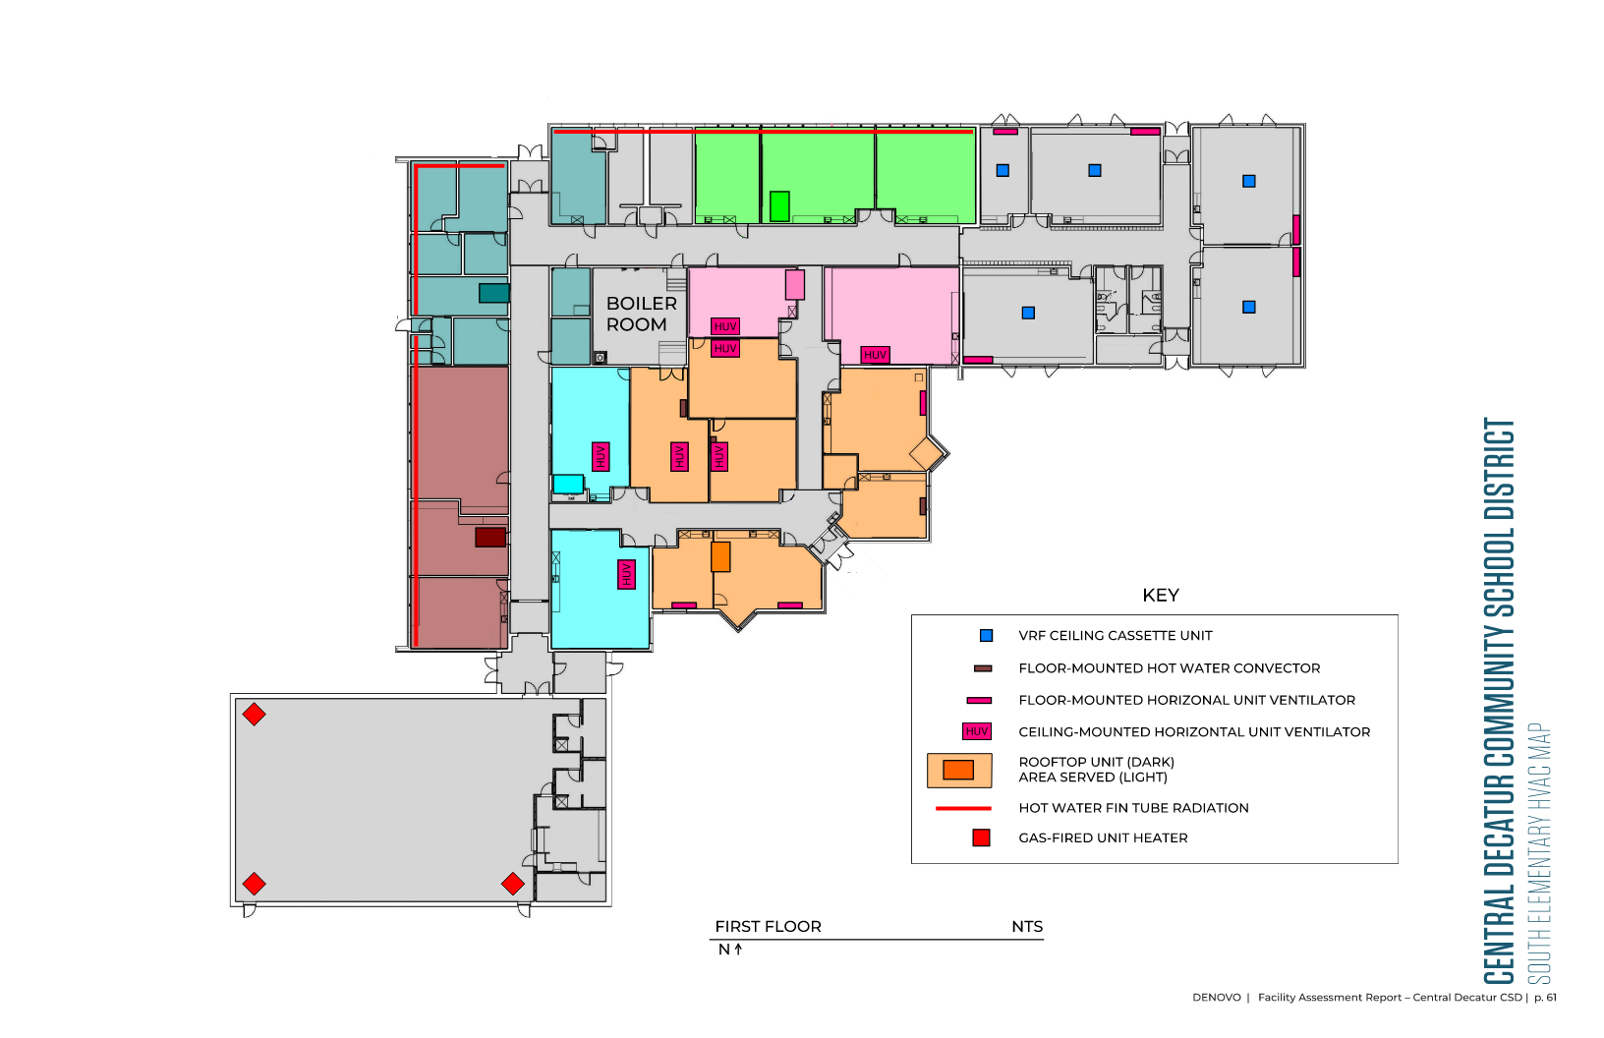

Slide 46
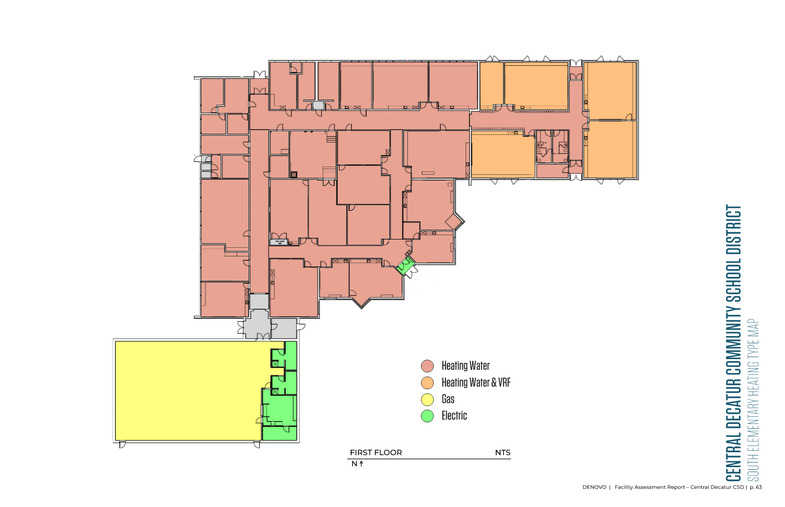

Slide 47
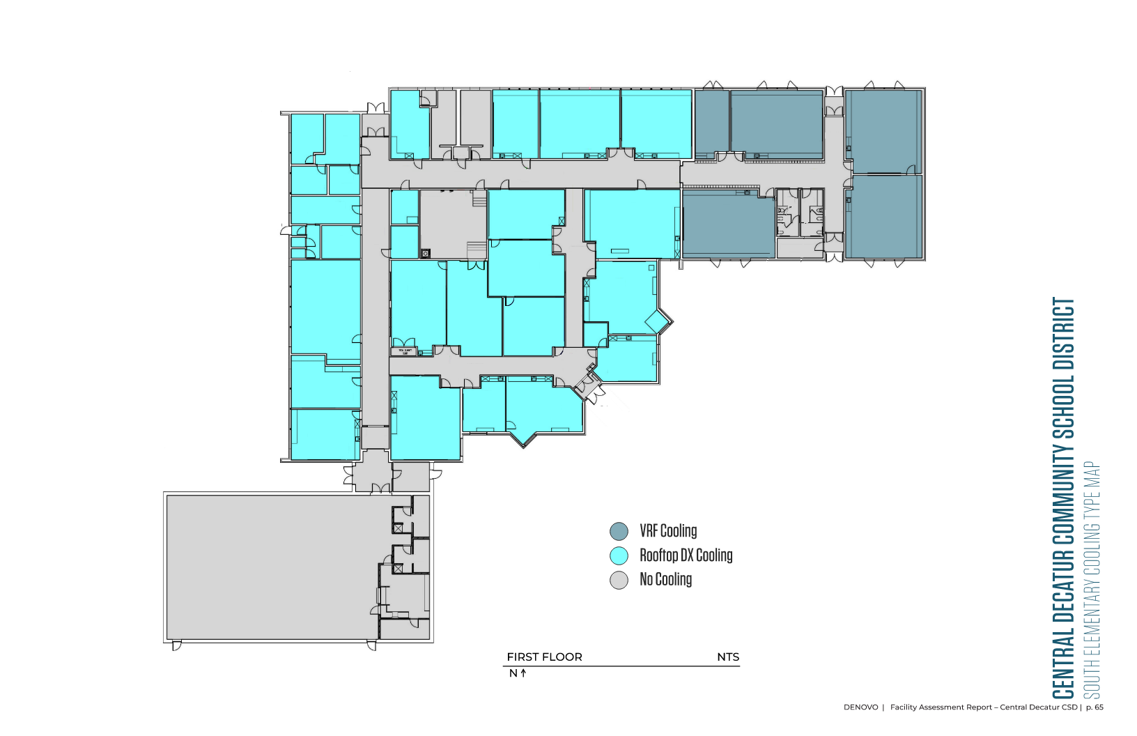

Slide 48
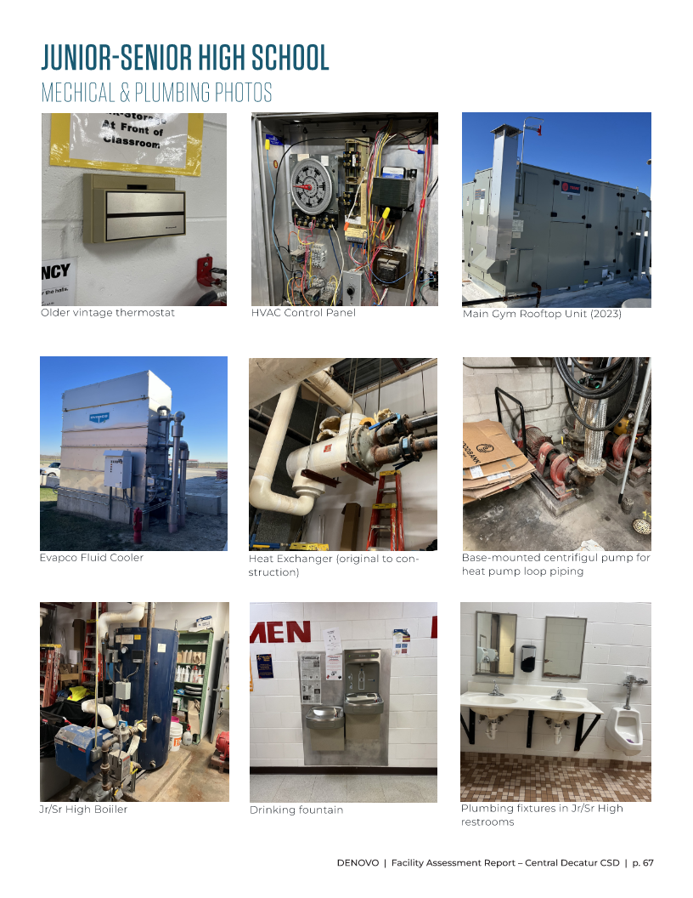

Slide 49
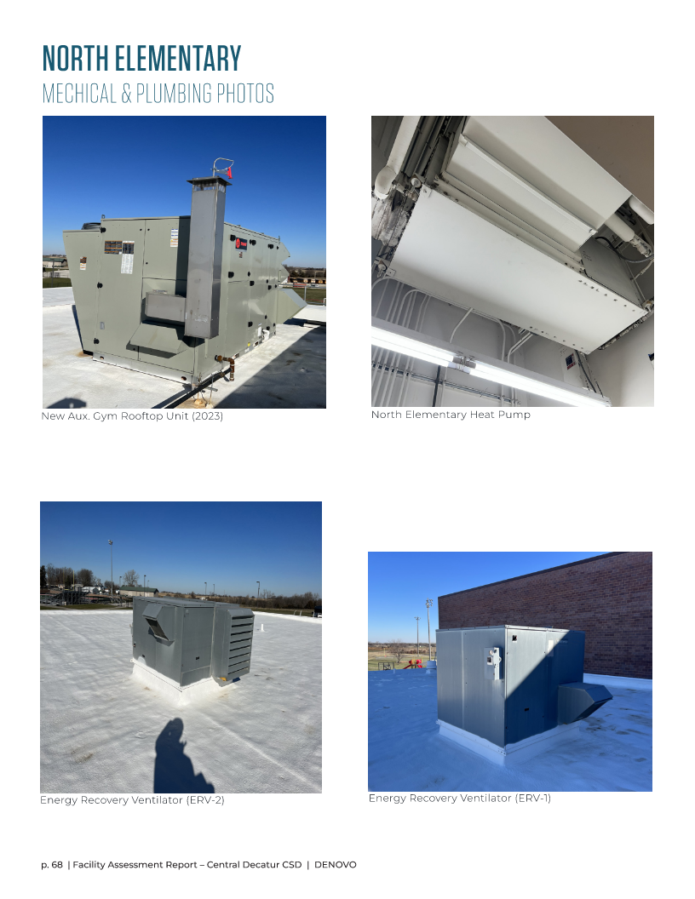

Slide 50


Slide 51


Slide 52


Slide 53


Slide 54


Slide 55



Slide 56

SURVEY OVERVIEW
91 total respondents
  37 Jr/Sr High Staff
  20 North Elementary
  24 South Elementary
  9 Multi-Site
Four open-ended questions

Slide 57
QUESTION #1
  "Reflect on your specific role within the school district and answer the following:
  What are three specific improvements within your personal classroom or learning space that would contribute to a more effective and enriching educational experience for your students?"

Slide 58
QUESTION #2
  "Continue to reflect on your specific role within the school district and answer the following:
  What are three specific improvements outside your classroom or learning space that would contribute to a more effective and enriching educational educational experience for your students?"

Slide 59
QUESTION #3
  "Now, reflect on your district as a whole and answer the following:
  What are some additional ways outside your specific role that the district could enhance and improve the educational, co-curricular, and/or overall student experience?
  Please list at least three specific improvements, and if applicable, share how current facilities may be limiting these aspects."

Slide 60
QUESTION #4
  "Lastly, reflect on the community within the East Buchanan school district and answer the following:
  What are three specific improvements you think the East Buchanan community (parents, residents, etc.) want to happen at the school?"

Slide 61
SURVEY SUMMARY
Improving restroom spaces was most mentioned at the Jr/Sr High. Additionally, staff noted furniture and casework upgrades and more small group break-out spaces throughout the facility.
North Elementary staff noted the need for furniture upgrades, drafty windows, and harsh fluorescent lighting
South Elementary staff noting improving restroom spaces and HVAC the most. Additional identified improvements consisted of upgrading the playgrounds

Slide 62
WHERE ARE WE GOING?

Slide 63


Slide 64
THANK YOU!

