Slide 1
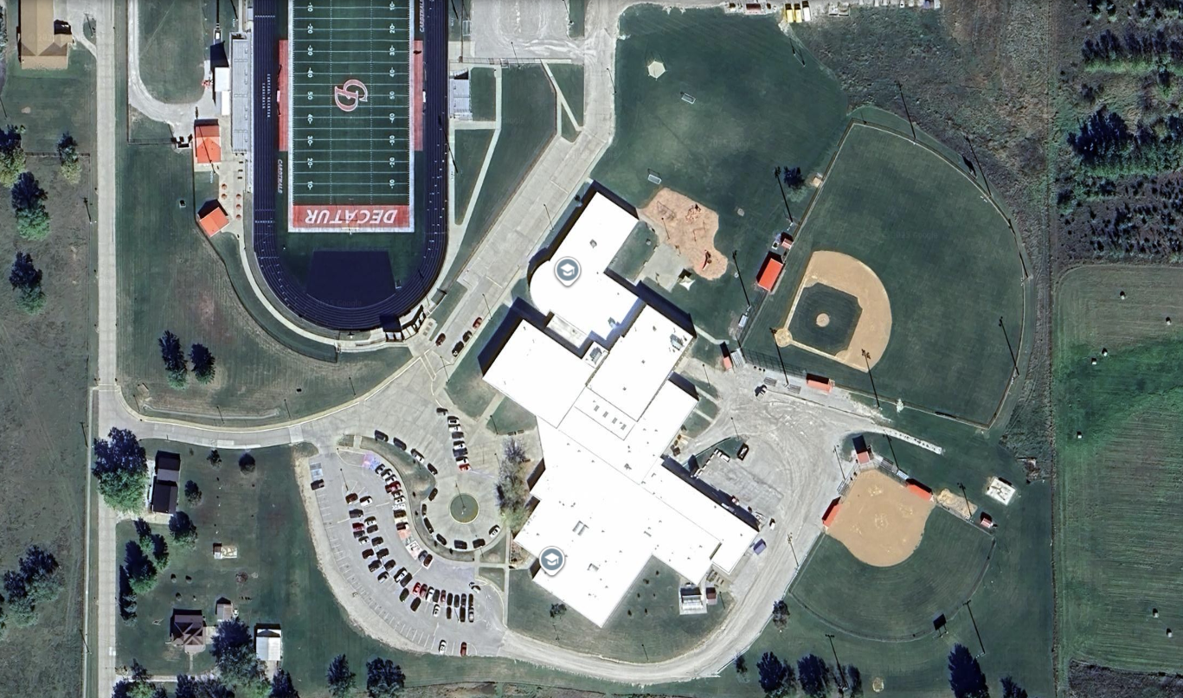

Central Decatur CSD
Planning for Success

Slide 2
TONIGHT’S AGENDA
Recap planning efforts to date
Central Decatur Enrollment & Programming
Review of District Financial Picture
Discuss Future of South Elementary
GOAL FOR TONIGHT: What’s the right path for Central Decatur CSD?

Slide 3
WHERE WE HAVE BEEN
November 5th, 2024
March 12th, 2025
June 11th, 2025
July 24th, 2025
September 11th, 2025
Initial Kickoff Meeting
FCA Report Delivery & Presentation
5-Year Maintenance Planning (Work Session)
Programming Meeting #1
Programming Meeting #2

Slide 4
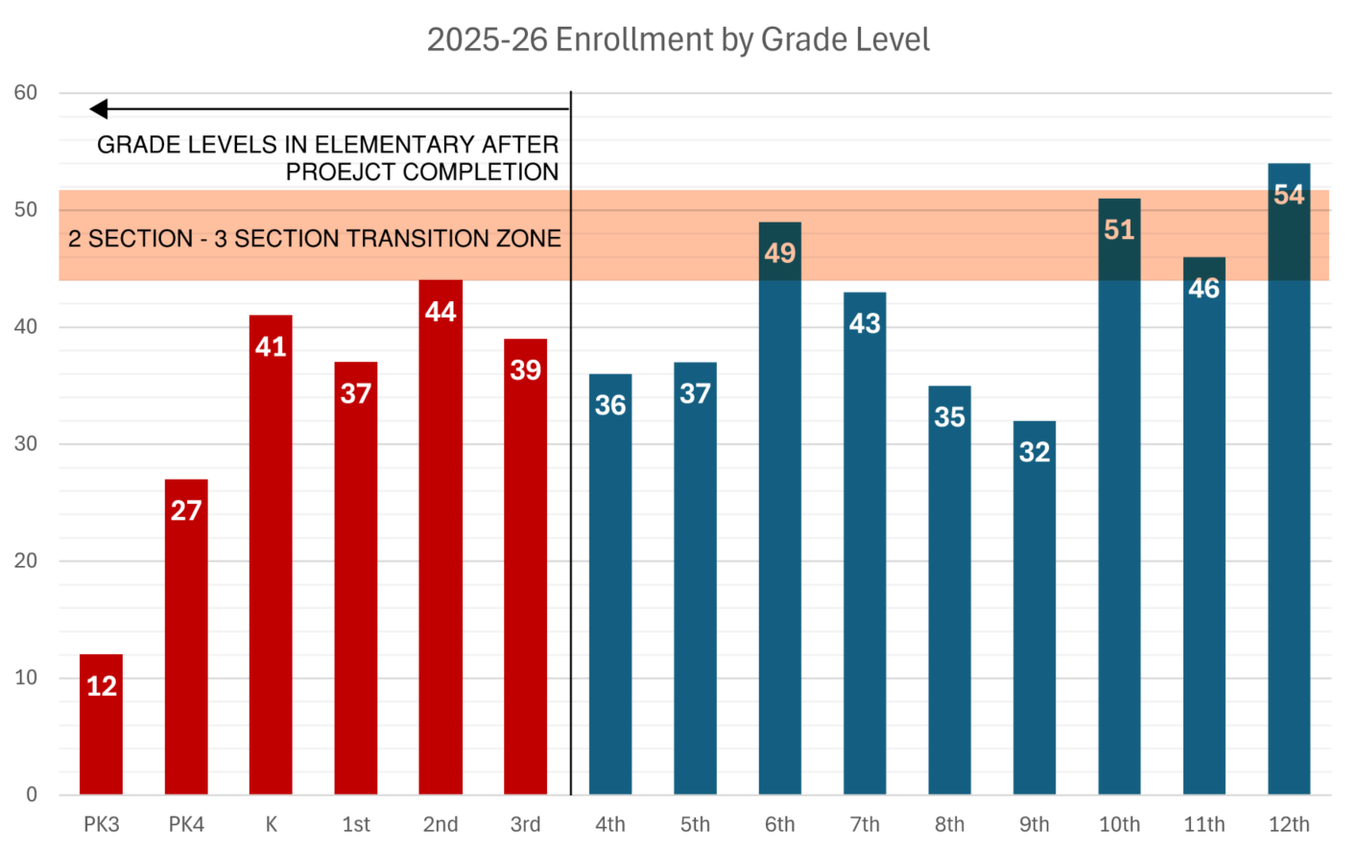
CENTRAL DECATUR ENROLLMENT
Notes:
24 max at primary
26ish at 3-5

Slide 5
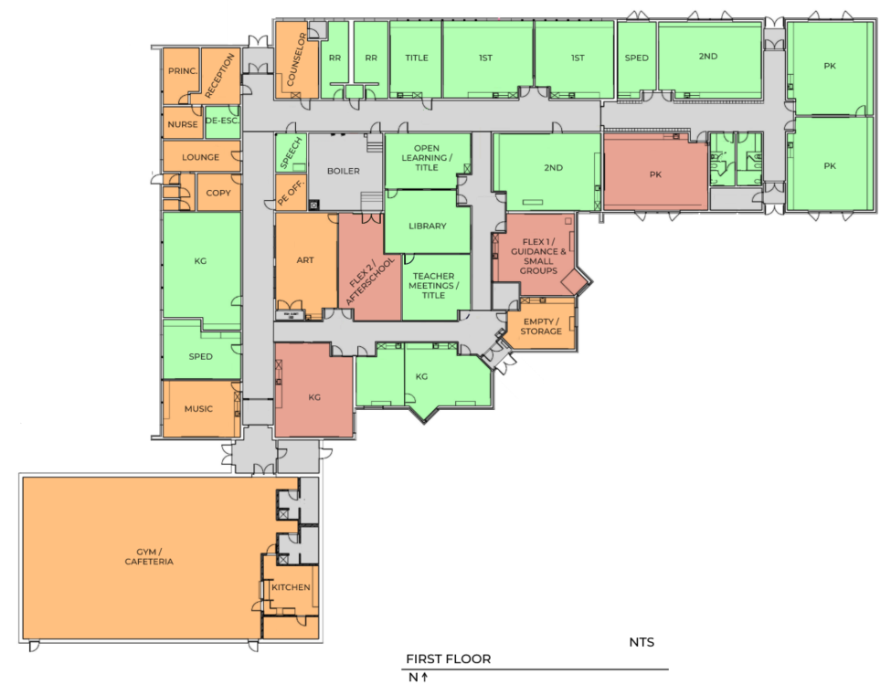
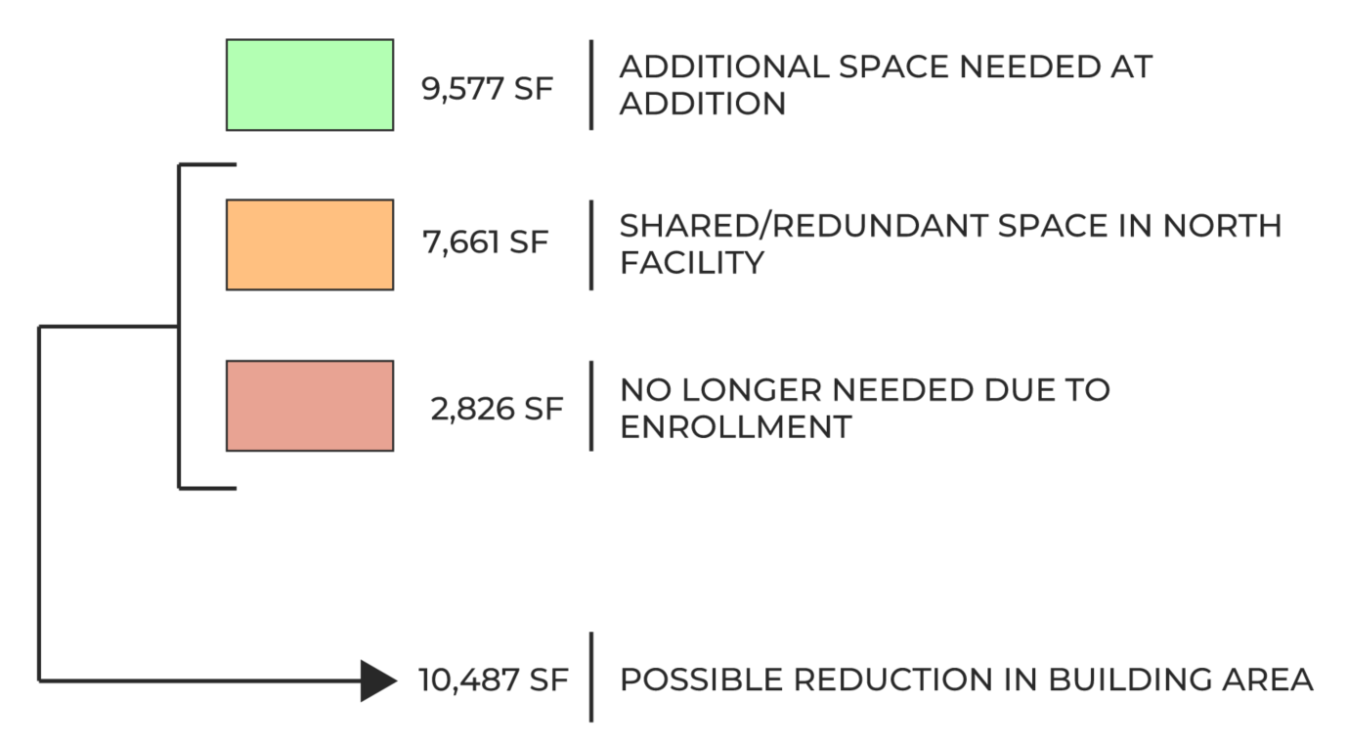
SOUTH ELEMENTARY PROGRAMMING

Slide 6
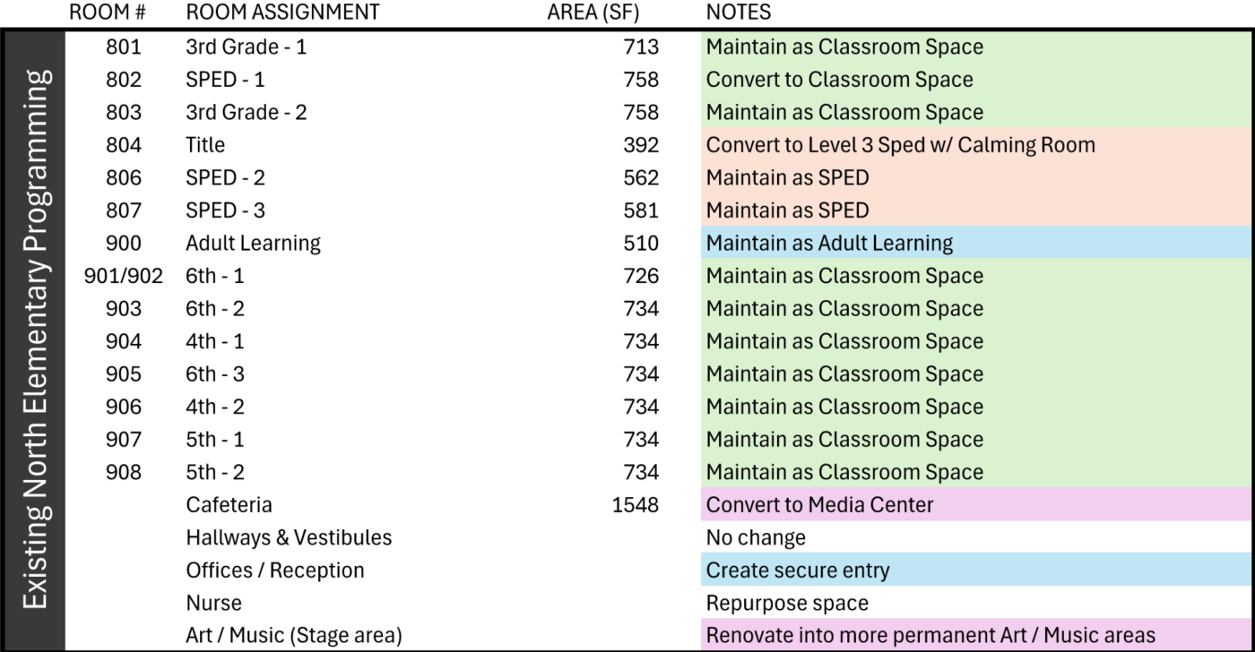
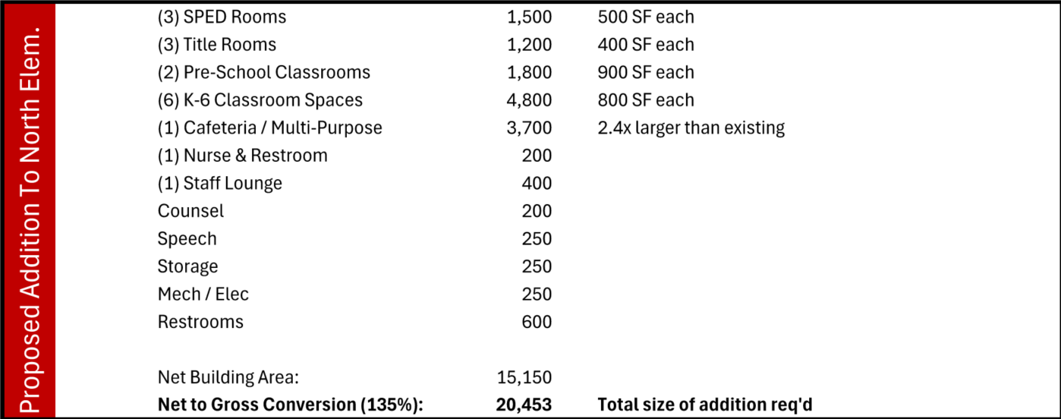
CONSOLIDATED ELEMENTARY PROGRAMMING

Slide 7
CONSOLIDATED ELEMENTARY PROGRAMMING (cont’d)
Primary Spaces
(16) K-6 Classrooms (includes 2 flex classrooms)
(2) Pre-School Classrooms
(5) Level 1 & 2 SPED Rooms
Level 3 SPED Room w/ Calming Room
(3) Title Rooms
Elementary Media Center
Elementary Art Room
Elementary Music Room
Support Spaces:
Elementary Staff Lounge
Adult Learning Room
Counselor’s Room
Speech Room
Nurse Room w/ Restroom
Auxiliary Gym
Cafeteria / Commons (ex maintained)
Warming/Serving Kitchen
Existing office space maintained
Auxiliary Spaces
Restrooms
Mechanical/Electrical Rooms
Storage / Custodial
Spaces listed represent all elementary-dedicated space after consolidation. This includes spaces in the proposed addition and within the existing footprint of North Elementary

Slide 8
RENOVATE VS. BUILD
Renovations of South Elementary: $8.2M
  Cost opinion based on maintenance items discussed during previous work session including full-facility HVAC upgrade
  Building renovations limited by low height from finished floor to bottom of existing structure above
Addition to North Elementary: $11.1M* - $15.5M*
  Cost opinion includes new playgrounds, parking & drop-off site improvements, renovations to existing elementary space, demolition of existing South Elementary, and construction of a new 18,000 – 22,000 SF PK-3 addition.
*Cost opinions are indicative of total project costs including design & construction management fees, contingency, construction escalation, and owner general conditions.

Slide 9
CENTRAL DECATUR FINANCIAL PICTURE
Up to $5,500,000 available through SAVE funds
Up to $10,100,000 available through $4.05 G.O. Bond
Figures courtesy of Piper Sandler as of Fall 2025
Notes:
Get Piper Sandler sheet from Chris

Slide 10
SINGLE CAMPUS EFFICIENCIES
Reduce loss of educational time with staff transfer between facilities
No more redundant/duplicated spaces
Reduce facility maintenance & utilities expenditures
Hedge against possible future enrollment decline by gaining a single, efficient and highly utilized facility

Slide 11
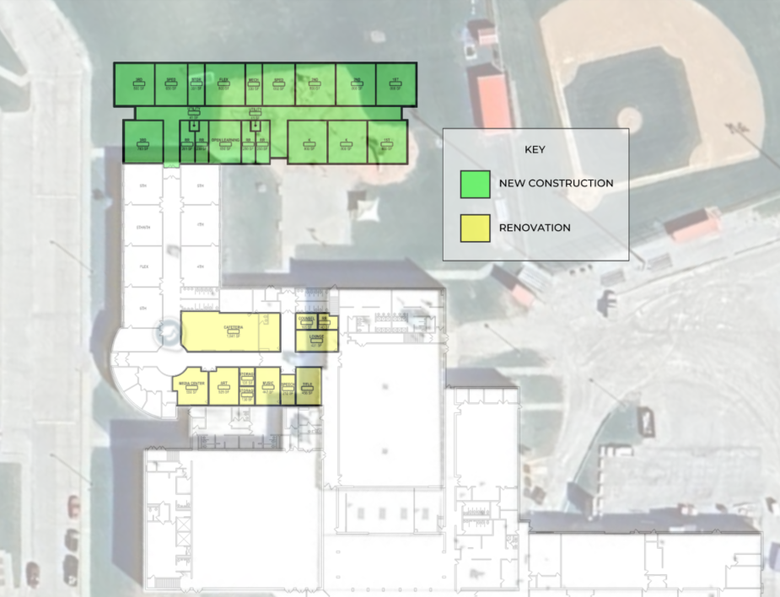
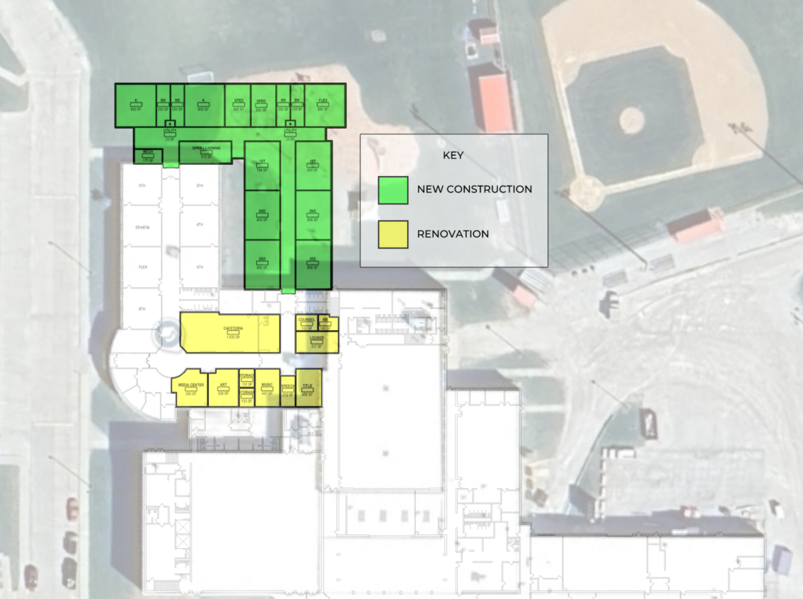
“ONE CAMPUS ONE FUTURE”

Slide 12
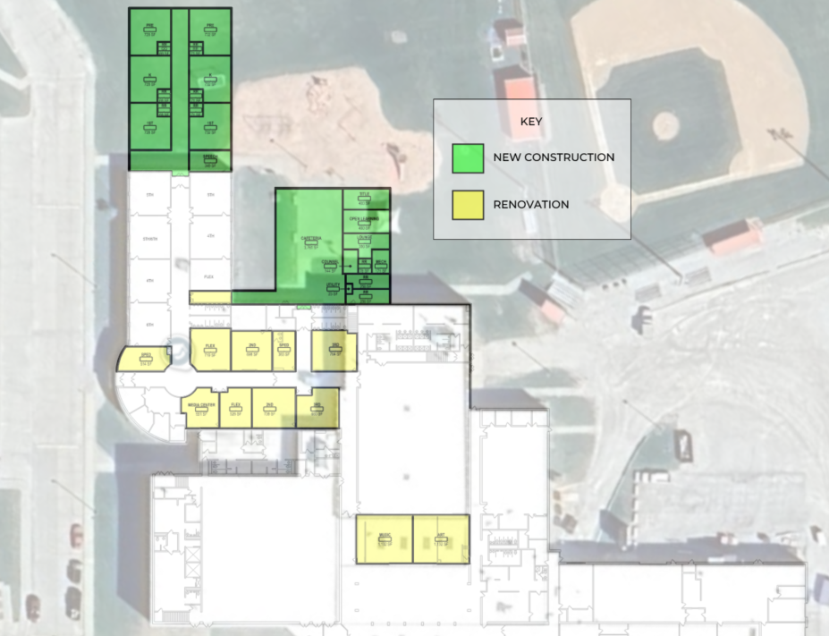
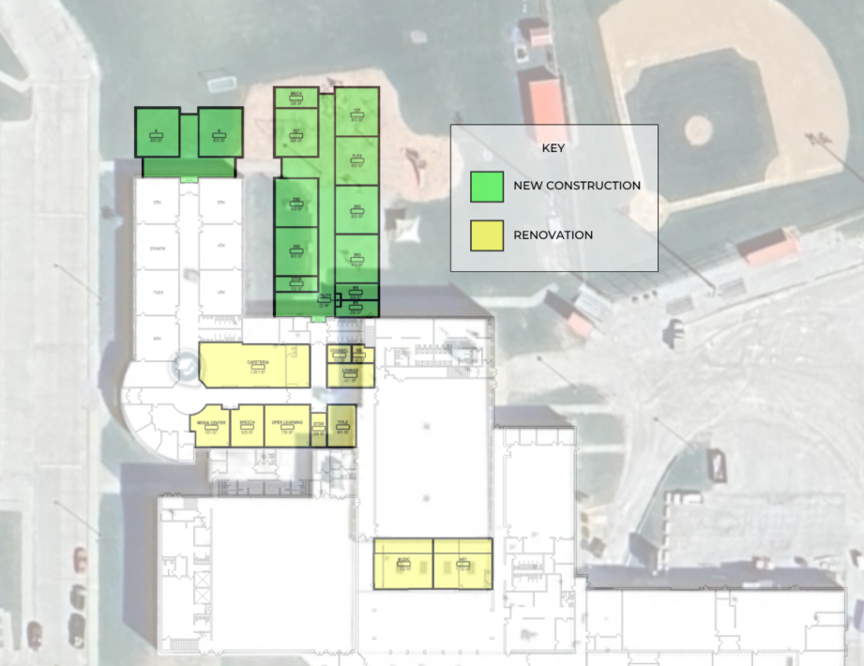
“ONE CAMPUS ONE FUTURE”

Slide 13
WHAT ABOUT THE JUNIOR-SENIOR HIGH?
Interior Finish Updates: Casework & Ceilings
CTE & Ag Program Improvements
Exterior Doors
Main Entry Vestibule
Heat Pump Replacements

Slide 14
WHAT HAPPENS TO SOUTH ELEMENTARY?
Raze building and sell land to developer, city, or donate land. (Could become a city park)
Raze majority of building and renovate gym space to create “rec center” for community use. (District pays for project and donates it to the city to maintain)
Raze majority of building but keep pre-school wing online
If there is no plan for South Elementary, the community will have a difficult time trusting that this is the right path for Central Decatur CSD.

Slide 15
THE MASTER PLANNING PROCESS
Conduct Facility Assessment [COMPLETE]
Core Planning Team Meetings: Key Staff & Faculty
Facility Committee Meetings: Staff, Board Members & Community Members
* Facility Committee to Present a Recommendation to the Board

Slide 16
POSSIBLE NEXT STEPS – OPTION 1
Dec. – Feb. 2026
February - April 2026
May 2026
June 2026
August – November 2026
Core Planning Team Meetings
Facility Committee Meetings
Board Work Session
Approve Plan & Begin Referendum Planning
Referendum Campaign

Slide 17
POSSIBLE NEXT STEPS – OPTION 2
Nov. 2025 – Aug. 2026
Sep. 2026 – Dec. 2026
Jan. 2027 – April 2027
May 2027
June 2027
Aug. – Nov. 2027
Begin Implementing 5-year Facility Plan
Core Planning Team Meetings
Facility Committee Meetings
Board Work Session
Approve Plan & Begin Referendum Planning
Referendum Campaign

Slide 18
POSSIBLE PROJECT TIMELINES
Nov. 2026
Dec. 2027 – May 2027
June 2027
July 2027 – Aug. 2028
June 2028 – Dec. 2028
Jan. 2029
Successful Referendum
Design Phase
Bid Project(s)
Construction of Addition
Renovations of Ex. Facilities
ONE CAMPUS COMPLETE
Nov. 2027
Dec. 2027 – May 2028
June 2028
July 2028 – Aug. 2029
June 2029 – Dec. 2029
Jan. 2030

Slide 19
DISCUSSION

Slide 20
THANK YOU!

