Slide 1
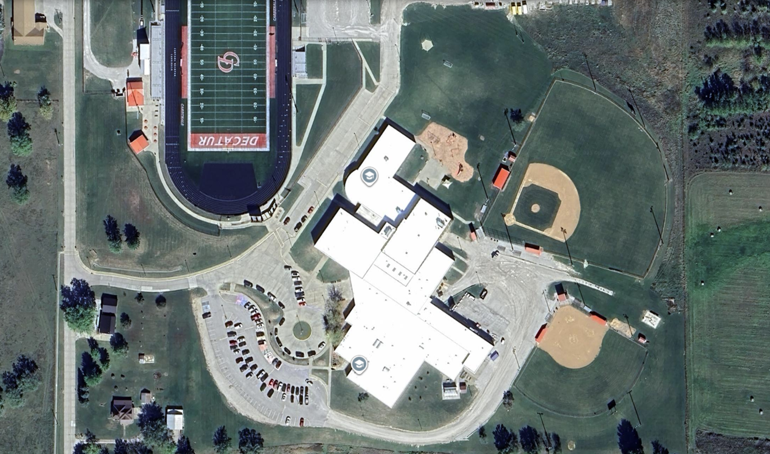




Central Decatur Community Meeting
Wednesday, April 22nd, 2026

Slide 2
Tonight’s Agenda
Timeline
The Master Planning Process
Master Plan Recommendation
Project Costs & Tax Impact
Why and Why Now?
What’s Next
Sharing the District’s Proposed Facility Master Plan

Slide 3
Timeline

Slide 4
Timeline of Facility Planning
2024
2025
2026
N D J F M A M J J A S O N D J F M A M J J A S O N D
ASSESSMENT
BOARD SESSIONS
STAFF SESSIONS
TASK FORCE
COMMUNICATION
TODAY
BOARD RECOMMENDATION
POTENTIAL BOND VOTE

Slide 5
The Master Planning Process

Slide 6
Facility Assessment Highlights

Slide 7
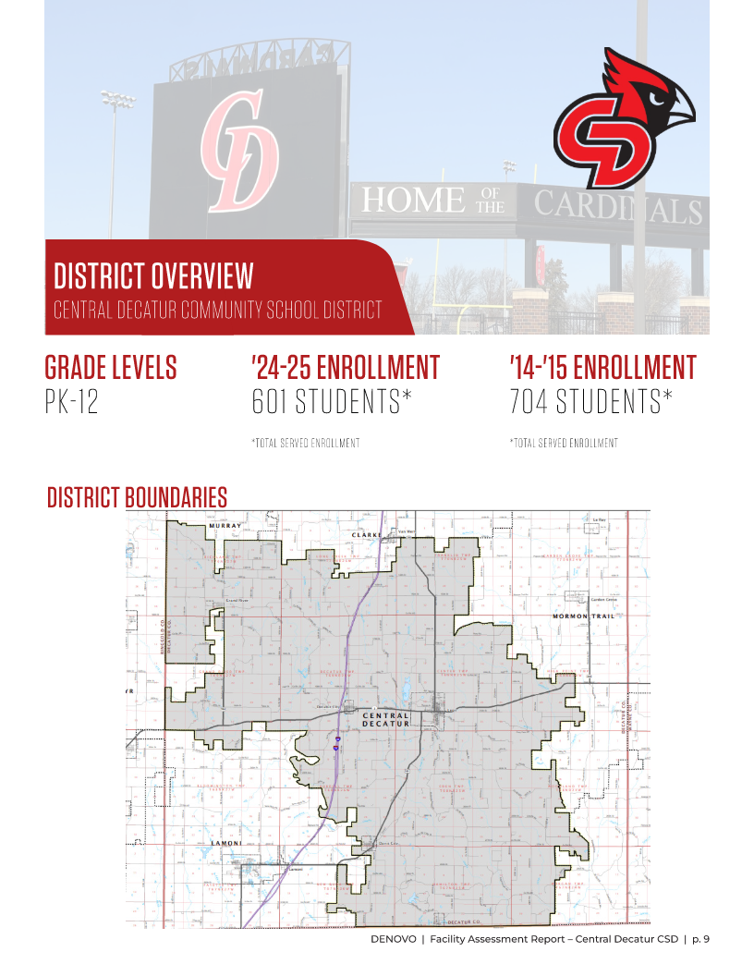
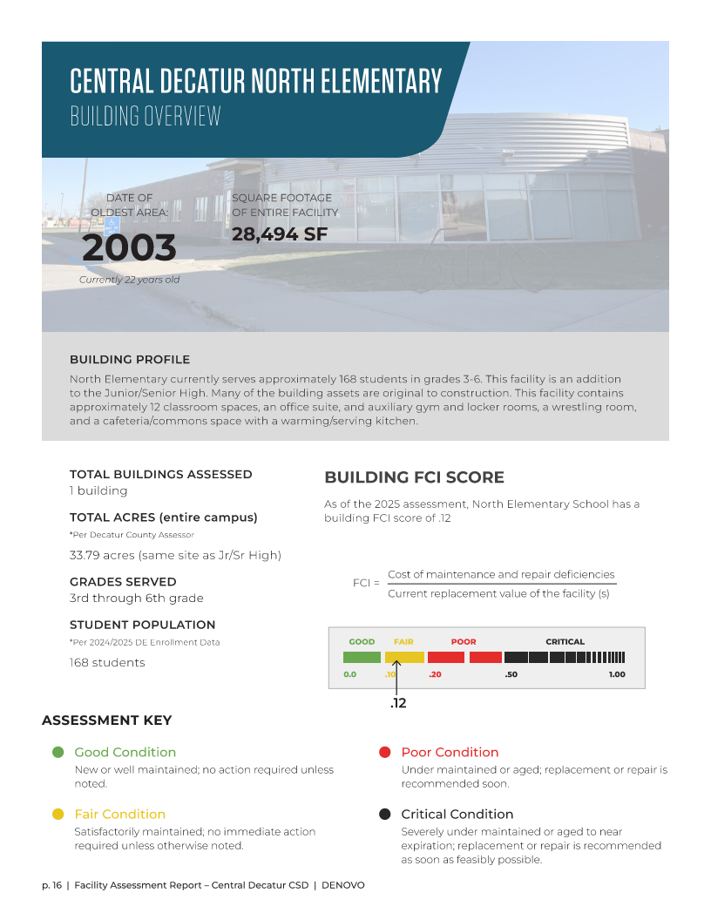
Facility Assessment Highlights
Completed March 2025
Detailed analysis of building system conditions, maintenance needs, and priorities
Foundation of the district’s 5-year maintenance plan
Includes staff survey and input on most critical needs from their perspective

Slide 8
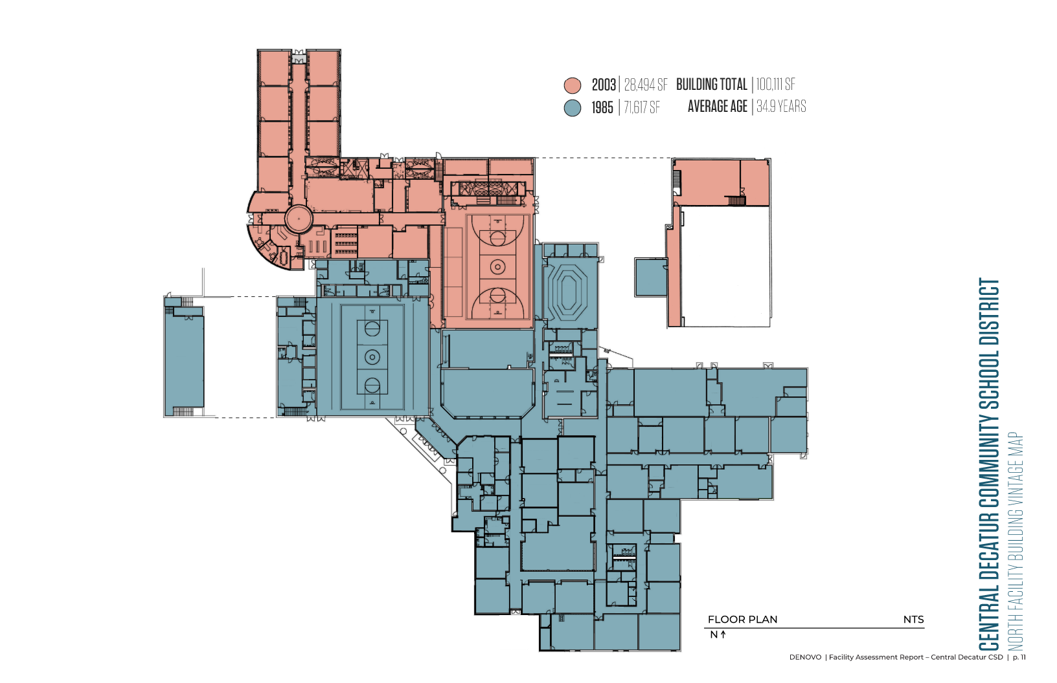

Slide 9
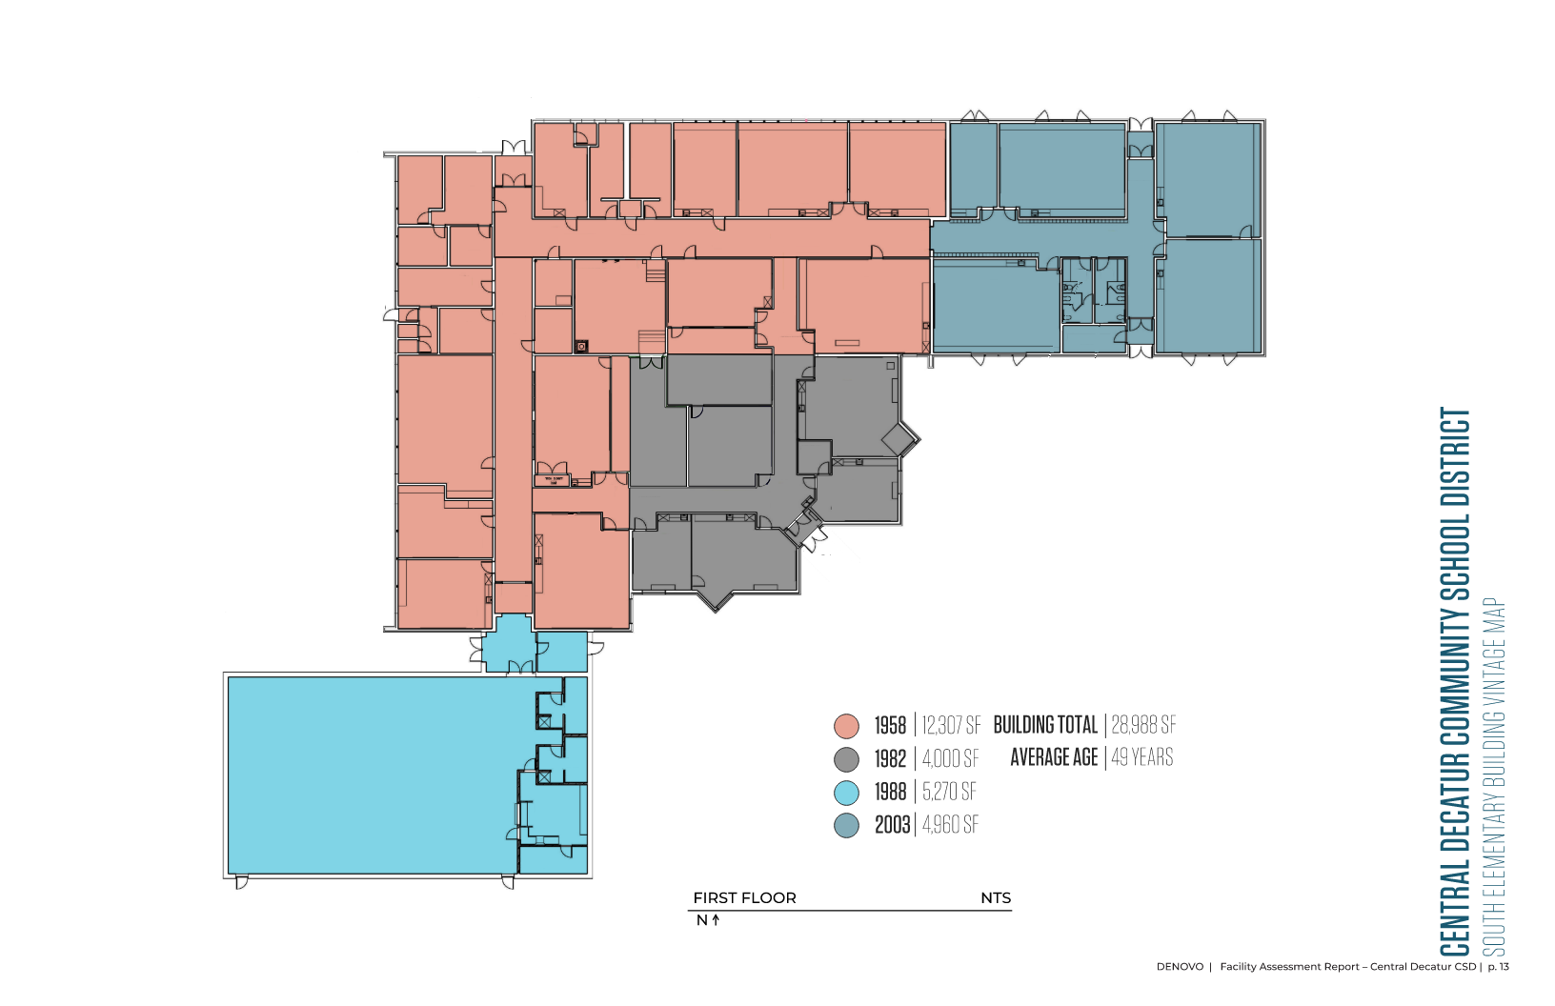

Slide 10
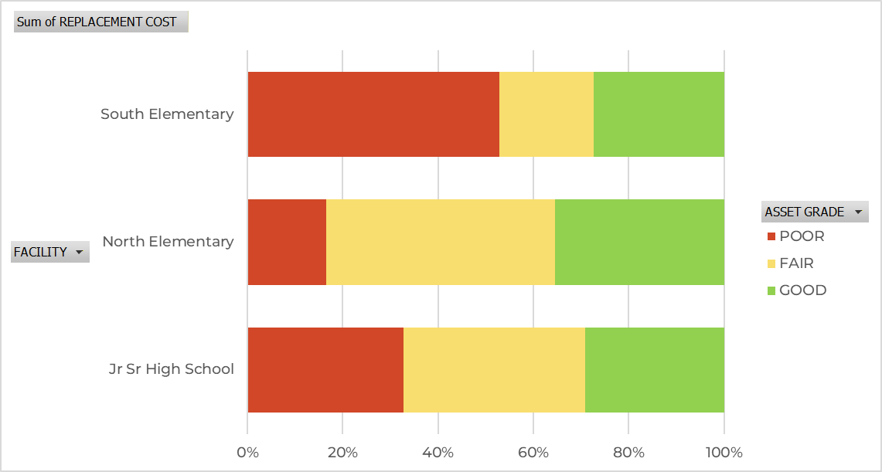
Facility Comparison

Slide 11
School Board Sessions

Slide 12
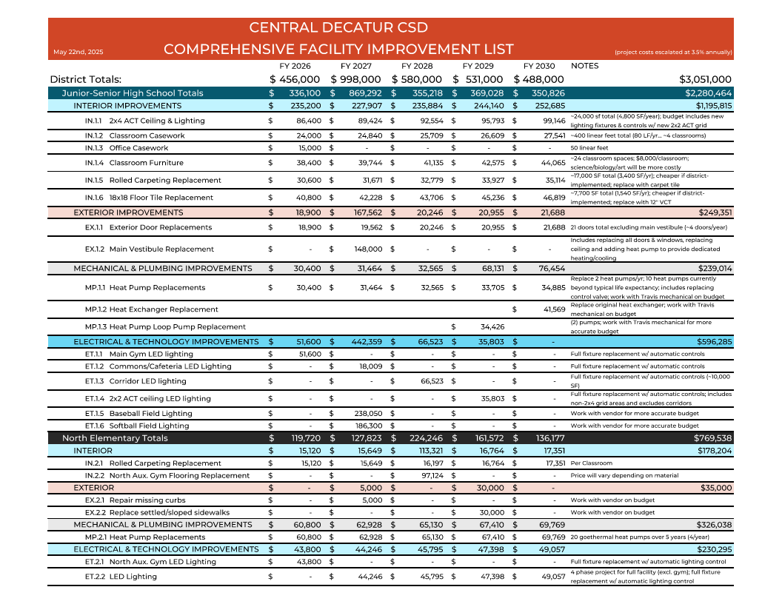
5-Year Maintenance Planning
Detailed maintenance planning for all facilities
The cost to maintain and renovate South is becoming difficult for the district to manage given current funding

Slide 13
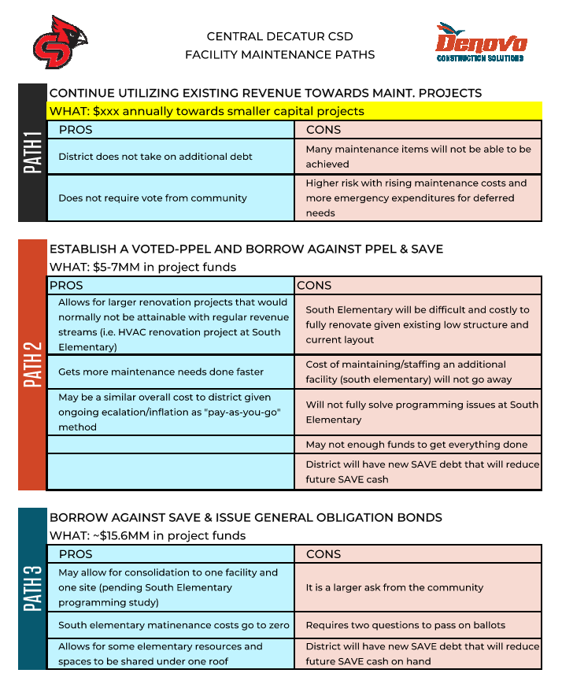
Paths to Fund Projects

Slide 14
Renovate South vs. Build Addition
Renovation Costs & New Construction Comparable
Why?
Redundant spaces in both locations (Art, Music, Office, etc.)
Declining enrollment (less classrooms needed)

Slide 15
Directive from Board of Education
Investigate & Plan for a consolidated PK-12 facility

Slide 16
Staff User Groups

Slide 17
Staff User Groups
When?
  Two meetings held in December & January
Who?
  Two groups - elementary group & Junior-Senior High Group
Why?
  Validate consolidation strategy
  Deeper understanding of programming
  Understand unique needs & challenges
  Review preliminary conceptual plans

Slide 18
Community Task Force

Slide 19
Purpose of Community Task Force
WHO?
  16 members | 5 staff & 11 community members
  Representative of a broad cross-section of the community
RESPONSIBILITIES
  Understand conditions of district facilities and financial standing
  Collaborate together to determine best direction for the district
  Conduct a transparent & community-led process
GOAL
  Provide a recommendation to the board of education

Slide 20
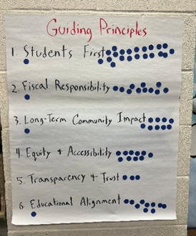
Meeting #1 Agenda - Understand
Guiding Principles
Facility Assessment Overview
Enrollment
School Finance 101
Central Decatur’s Financial Picture
One Campus vs. Two Campuses
Career-Based Learning
Preliminary concept presentation

Slide 21
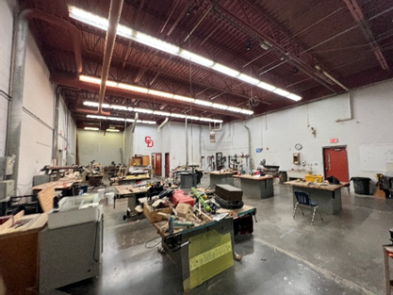
Meeting #2 Agenda - Contemplate
Meeting #1 Recap
North Campus Facility Tour
Taxes & Budgets
“Build-A-Project” Exercise
Group Discussion

Slide 22
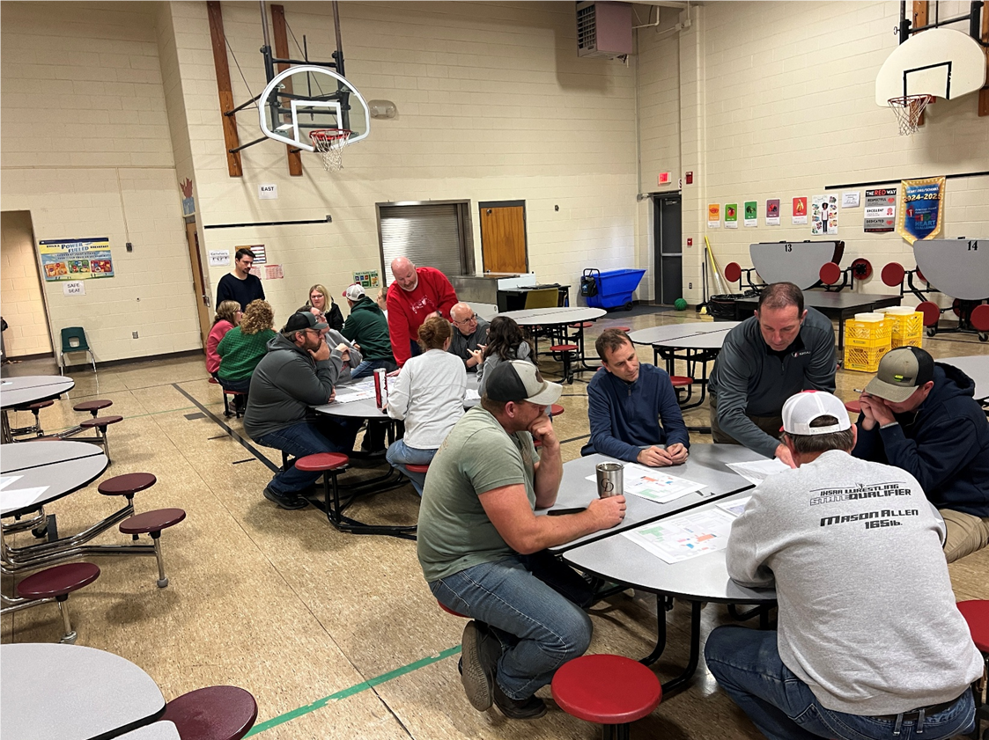
Meeting #3 Agenda - Recommend
Meeting #2 Recap
South Elementary Facility Tour
Project Refinement
The Plan for South
Why and Why Now?

Slide 23
Master Plan Recommendation

Slide 24
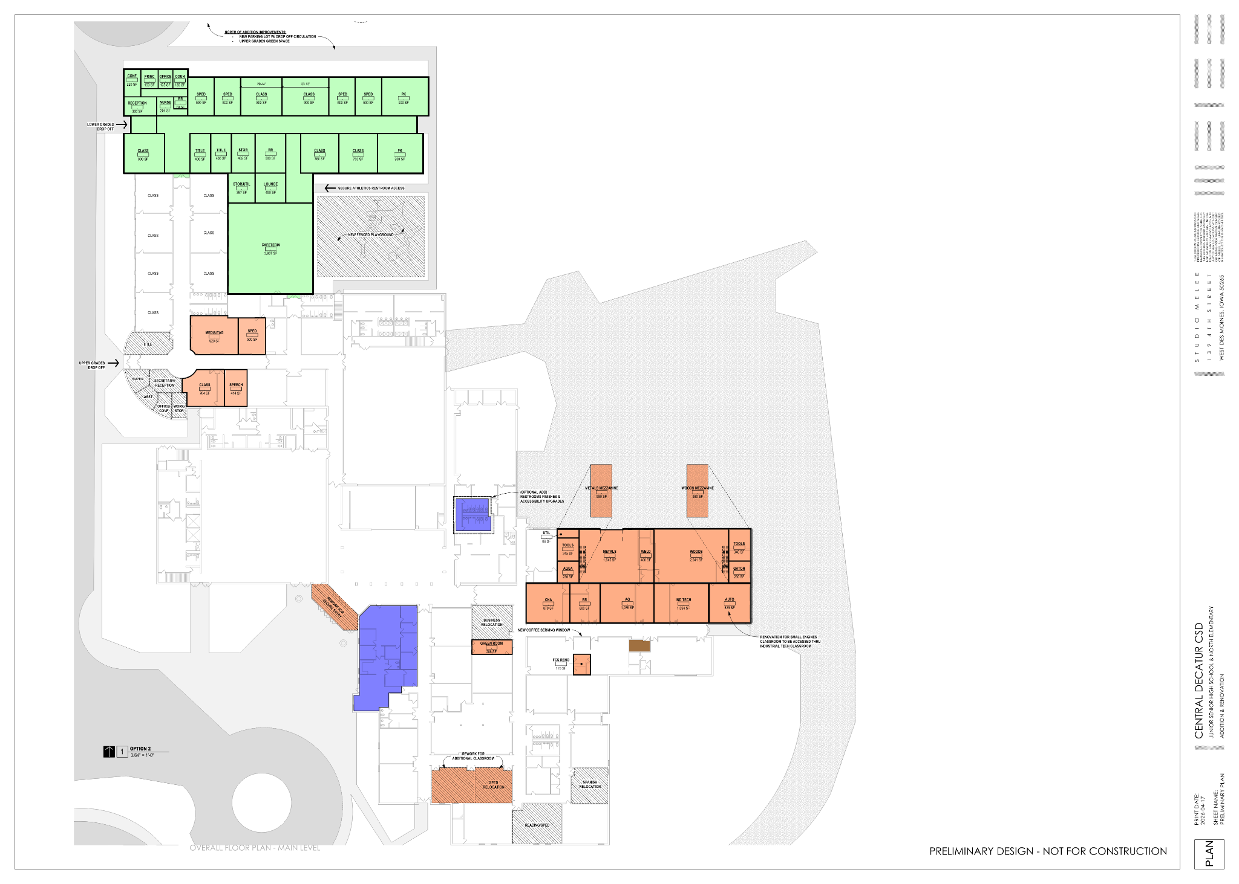

Slide 25
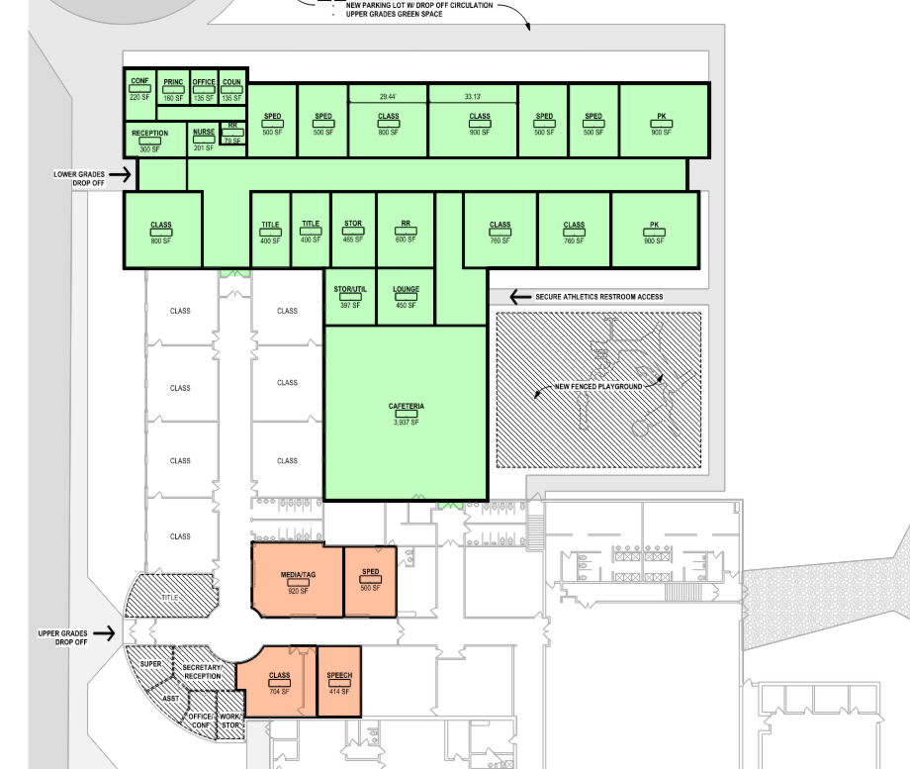
Elementary
18 Total Elementary Classrooms (7 in addition)
New Elementary Office Space
  Forced Entry Vestibule
  Central Office backfills
Expanded Cafeteria space
  Existing cafeteria infilled with learning spaces
New Playgrounds
Elementary Programming Stays Separate

Slide 26
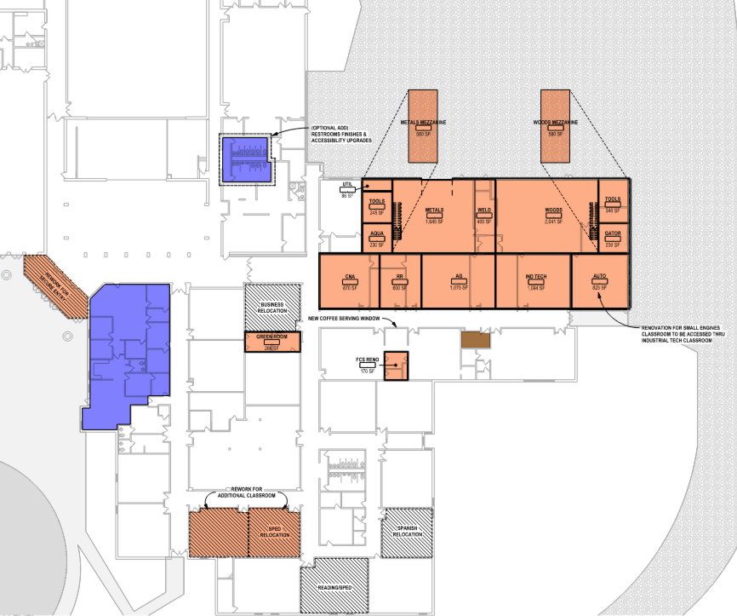
Junior-Senior High
Facility-Wide Improvements
  Exterior Door Replacements
  Ceiling Replacements
  Classroom casework upgrades
Forced-Entry Vestibule
Centralized CTE wing (career-based learning)
CTE upgrades & renovations
  Code-compliant storage
  Updated & right-sized classrooms
  Improved welding exhaust & dust collection

Slide 27
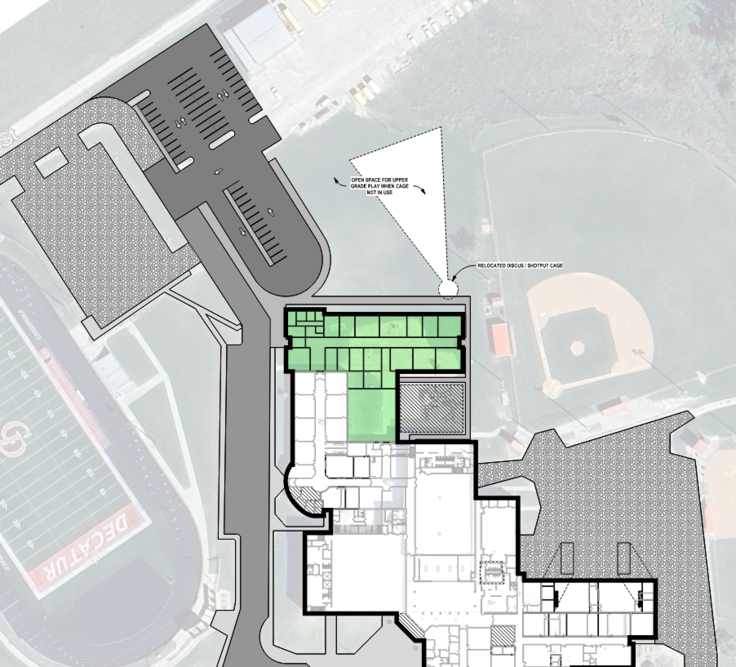
Site
Expanded parking
Separate parent & bus pick-up and drop-off loops
Improved traffic flow
Improved safety
Maximize green space for playground & recess usage

Slide 28
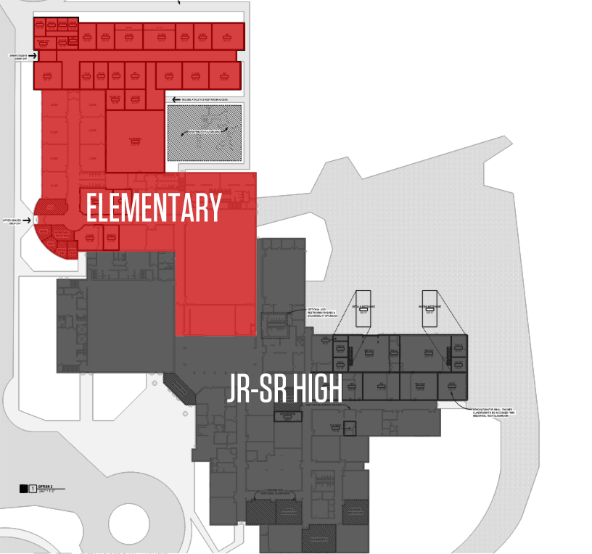
Facility Separation
PK through 6th completely separate from 7th-12th programing
Separate kitchen & cafeteria spaces
Separate gym & multi-purpose space

Slide 29
What Happens to South?
Demolish | $320,000 | Sell land Donate Land to City Keep land
Keep Gym | $900,000 - 1,100,000 | Relocate Utilities, New Parking, New Entrance, New HVAC
Keep Gym & Renovate (Light) | $1,900,000 | Restroom renovations, new lighting, gym floor replacement, paint/finishes
After discussing many options for the use of South Elementary, the task force recommends that the building be demolished
Currently no community use in place
Important that no further maintenance expenses be incurred by the district
Notes:
Add this to feedback or slide

Slide 30
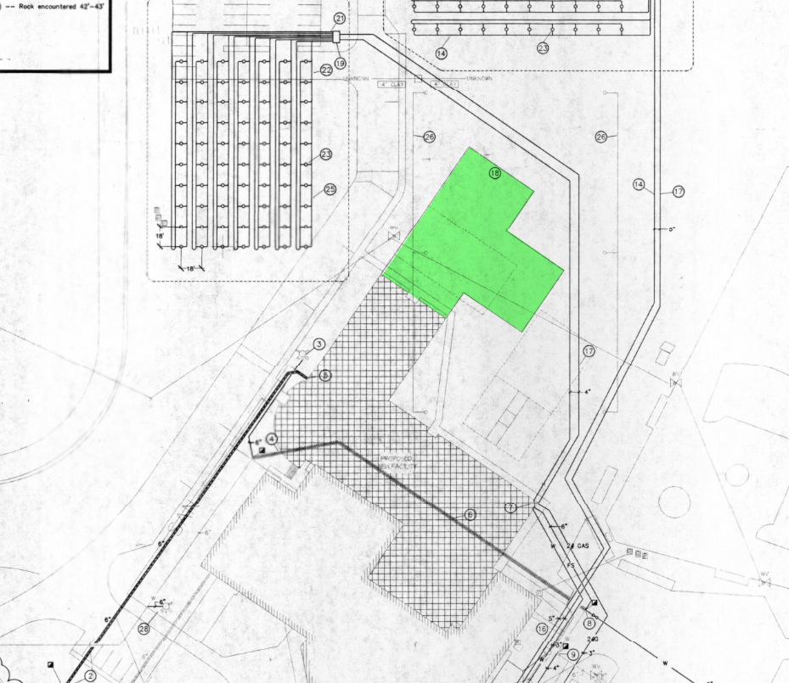
Completing the Plan!
The Bond issue in 2001 had the end goal in mind
The original plans anticipated the district’s needs for this project… 25 years ago!
Space was allocated appropriately with the design of North Elementary’s geothermal HVAC system

Slide 31
Project Cost & Tax Impact

Slide 32
Project Costs
Elementary Addition, Renovations & Demolition of South
$10.5M*
*Total Project Budget
Junior-Senior High Renovations & CTE Upgrades
$4.6M*
*Total Project Budget

Slide 33
Funding Sources
District funds $3.7M*
  Funding comes from bonding against recurring revenues dedicated toward facility maintenance
  Final dollar figure to be determined after financial advisor review with school board
Community funds $11.4M
  Funding comes from sale of General Obligation Bonds to be voted on by district residents (property tax impact)

Slide 34
Property Tax Impacts*
PROPERTY TYPE | ASSESSED VALUE / # OF ACRES | ANNUAL TAX INCREASE | MONTHLY TAX INCREASE
Residential | $200,000 | $341.09 | $28.42
Commercial | $250,000 | $911.25 | $75.94
Agricultural | 100 acres | $160.56 | $13.38
*Data represented comes from analysis by the district’s financial advisor, Piper Sandler as of x/xx. Values are subject to change

Slide 35
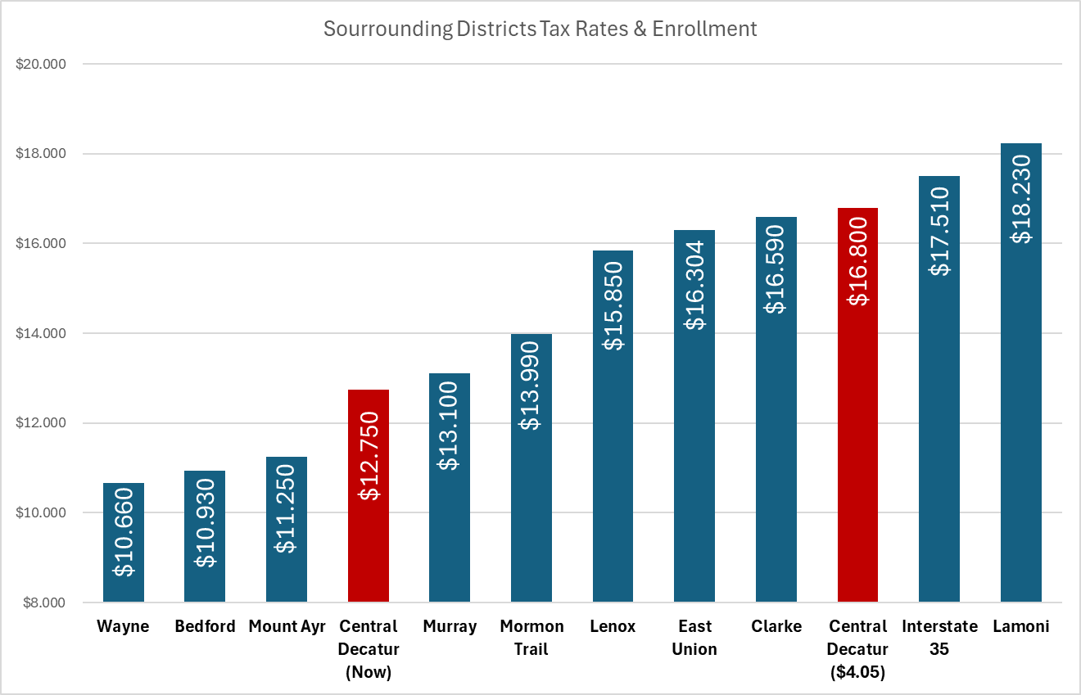
Voted PPEL Only
Debt Service Levy Only
Debt Service AND Voted PPEL

Slide 36
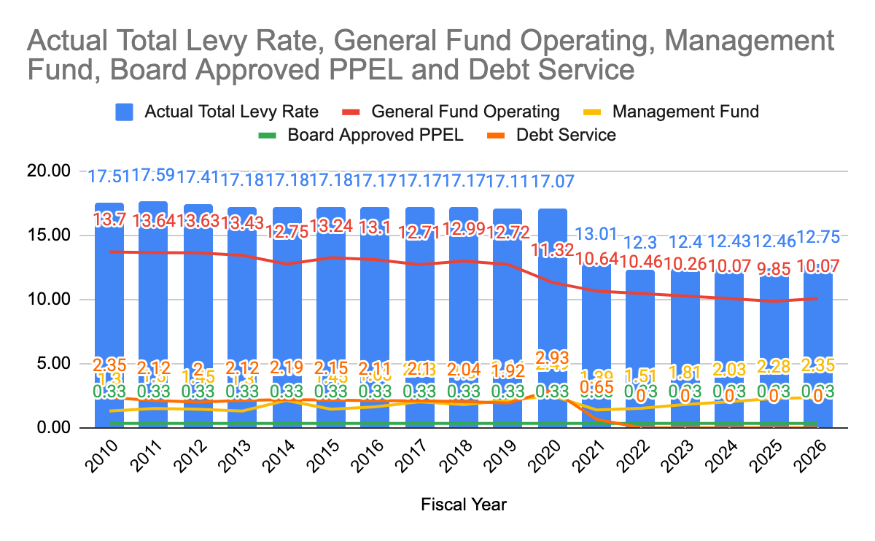

Slide 37
Central Decatur Bond History
YEAR | PROJECT | TOTAL BOND AMOUNT | TODAY’S COST (2027 Dollars)
2026 | One Campus Master Plan |  | $11,400,000
2001 | North Elementary & South Elementary PK Addition | $5,502,905 | $12,360,000
1985 | Jr-Sr High School Building | Unknown at this time. | $36,000,000
Notes:
Determine where this slide falls in the deck

Slide 38
Central Decatur Recent & Annual Projects
Recent Capital Projects:
  (2023) Fluid Cooler, Gym HVAC, & Roof Coatings: $1,857,300
  (2015) Football/Track Upgrades & Bus Barn: $5,275,335
Ongoing Maintenance/Transportation Needs:
  Annual Maintenance: ~$50,000
  Annual Technology: ~$175,000
  Annual Transportaion: ~$150,000 (Cost of a bus = $135,000)
  Annual Debt Service: ~$544,000 (retires in 2029 & 2030)
Total Annnual SAVE/PPEL Revenues: ~$900,000
Notes:
Determine where this slide falls in the deck

Slide 39
Why and Why Now?

Slide 40
Enrollment
Fiscal Responsibility
Operational Efficiency

Slide 41
Enrollment

Slide 42
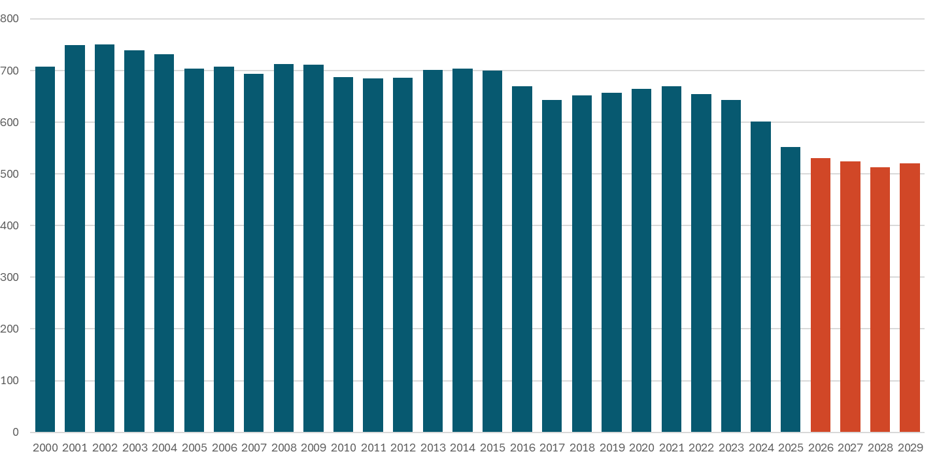
Historical & Projected Enrollment
736
706
693
664
647
528

Slide 43
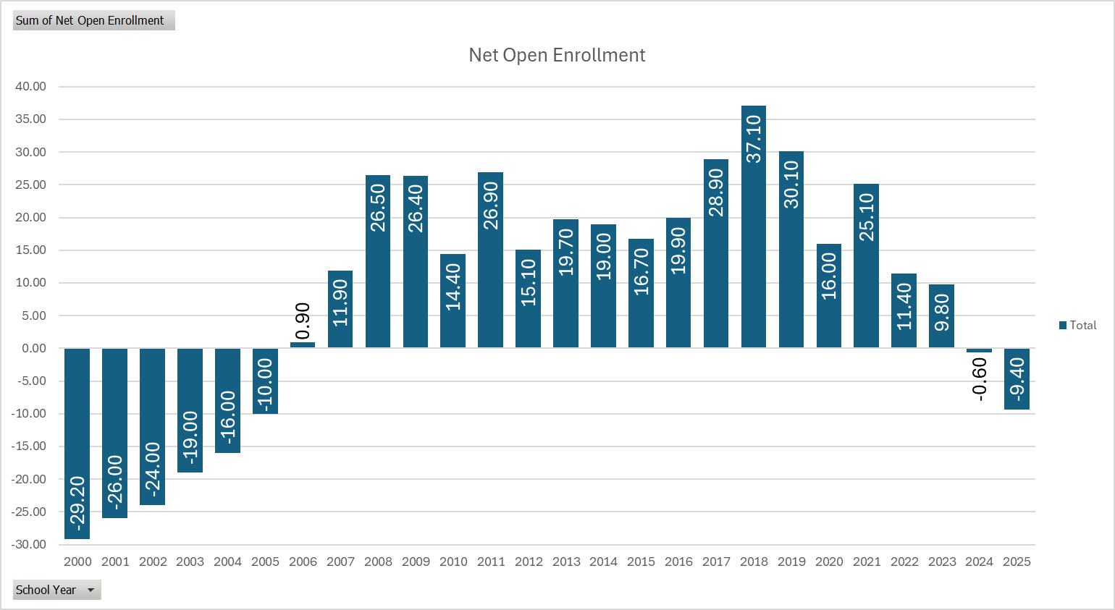
Net Open Enrollment
North Elementary
Football/Track

Slide 44
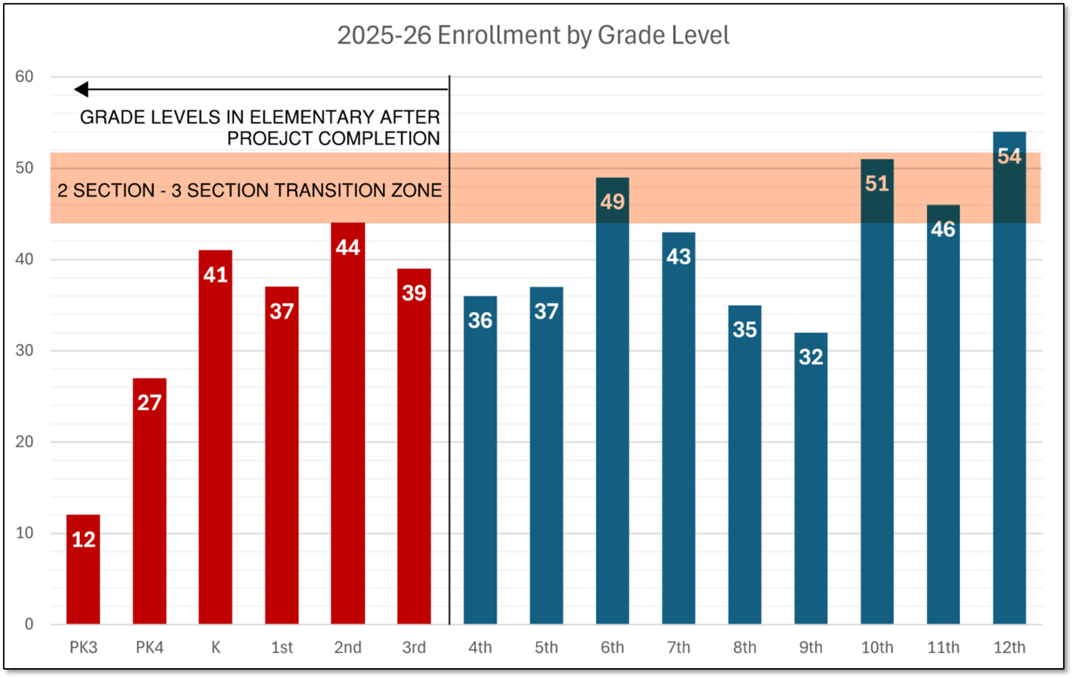
Grade Level Enrollment

Slide 45
2. Fiscal Responsibility

Slide 46
Build vs. Renovate South
BUILD
$10.5M*
*Total cost to consolidate to one facility
RENOVATE
$8.2M*
*Projected budget to rectify known deficiencies from facility assessment

Slide 47
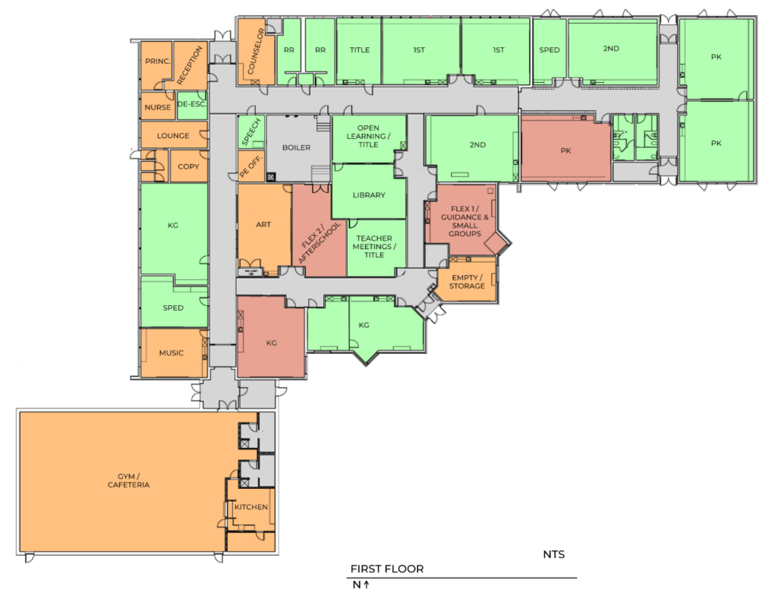
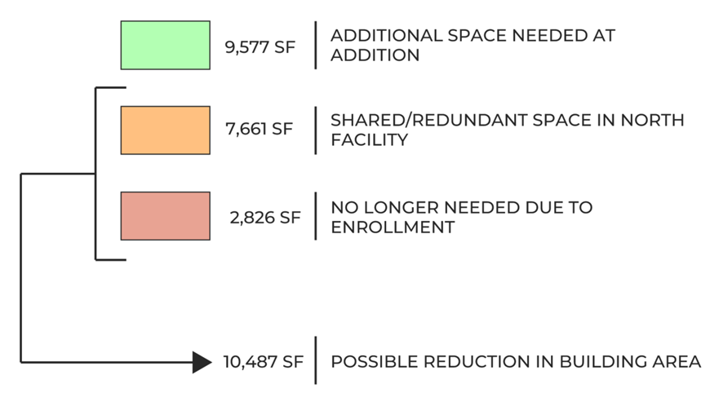
South Elementary Utilization
Over 10,000 SF of redundant or un-utilized space
Renovate ~30,000 square feet or build ~20,000 square feet
NO Student Displacement During Construction w/ Build Option

Slide 48
3. Operational Efficiency

Slide 49
Operational Impacts
1 Month of Time Saved Annually Per Department
Transportation & Food Service
  One location for pick-up & drop-off
  One location for food service prep & delivery
Increased Dedicated Educational Time
  Staff no longer need to travel to and from buildings
Reduced Annual Maintenance Expenditures
  Less overall building area to maintain
  One site to maintain
  Newer facilities (lower annual maintenance costs)
Notes:
Have Amy speak to this slide

Slide 50
Operational Impacts (cont’d)
Estimated $x00,000 in annual savings
$2.3M premium estimated to pay back before bond is paid off (less than 20 years)

Slide 51
Why CTE Improvements?

Slide 52
Why CTE Improvements?
Existing CTE infrastructure and finishes are largely original to 1985 and in need of improvement
Existing CTE programming is segmented and doesn’t function well with existing building layout
Strong CTE Programs are critical for rural Iowa districts
Notes:
Have Dan or Caleb speak?

Slide 53
Timeline
The Master Planning Process
Master Plan Recommendation
Project Cost & Tax Impact
Why and Why Now?
What’s Next

Slide 54
What’s Next
Board Meeting in May
  Final project refinement by BOE
  Master plan up for approval
Petition signatures (assumes board approval of master plan)
  If you would like to be involved in gathering petition signatures, or help the district communicate the project, contact Becky Broich becky.broich@centraldecatur.org
Referendum Campaign (August - November)
Notes:
Have staff speak?

Slide 55
The Board and Task Force Want to Hear from YOU!
Please fill out the feedback form and hand it to a Denovo representative or Mr. Coffelt before leaving.
Please feel free to engage in conversation with a task force member or Denovo representative.

Slide 56
Thank You!

